Slide 1
ECEN 390 Electromagnetics
Transmission Lines 2

Slide 2
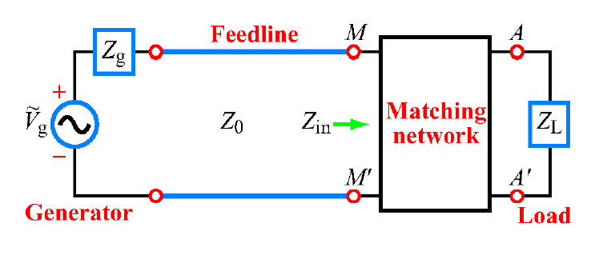
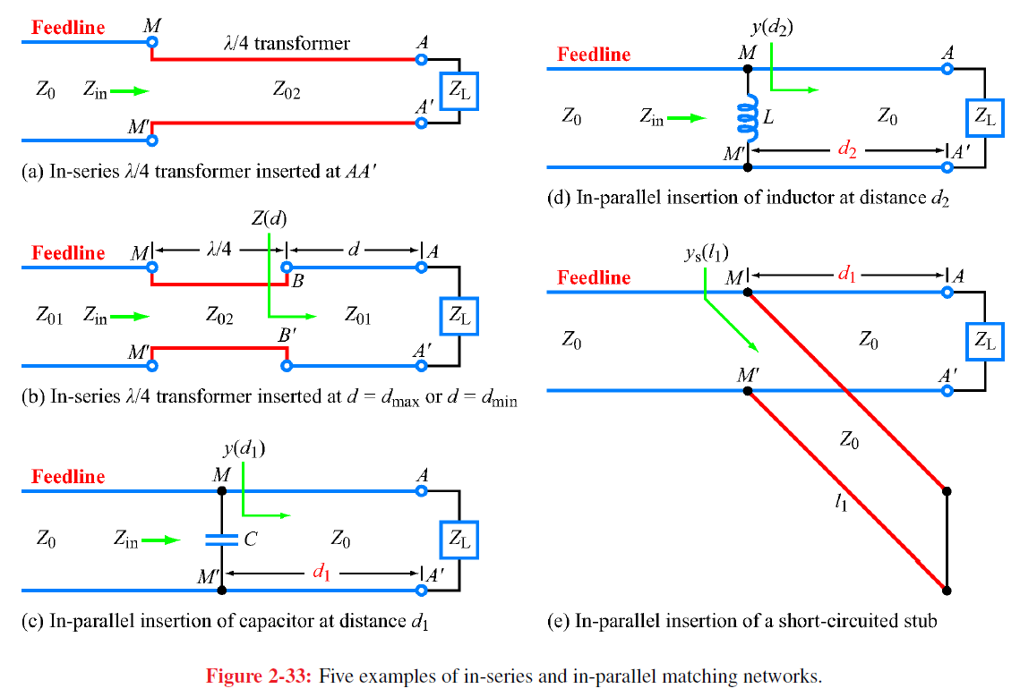
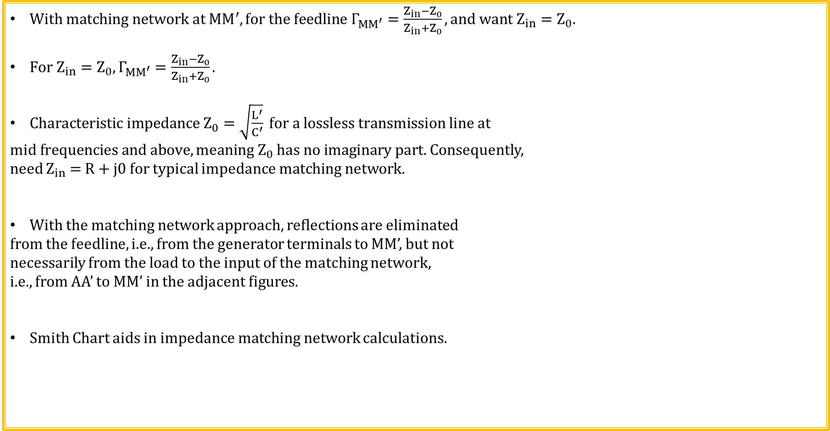
Impedance Matching
$With matching network at {MM}^{′}, for the feedline Γ_{{MM}^{′}}=\frac{{Z_{in}−Z}_{0}}{{Z_{in}+Z}_{0}}, and want Z_{in}=Z_{0}$.
$For Z_{in}=Z_{0}, Γ_{{MM}^{′}}=\frac{{Z_{in}−Z}_{0}}{{Z_{in}+Z}_{0}}.$
$Characteristic impedance Z_{0}=\sqrt{\frac{L^{′}}{C^{′}}} for a lossless transmission line at$
$mid frequencies and above, meaning Z_{0} has no imaginary part.$Consequently,
need $Z_{in}$ = R + j0 for typical impedance matching network.
With the matching network approach, reflections are eliminated
from the feedline, i.e., from the generator terminals to MM’, but not
necessarily from the load to the input of the matching network,
i.e., from AA’ to MM’ in the adjacent figures.
Smith Chart aids in impedance matching network calculations.

Slide 3
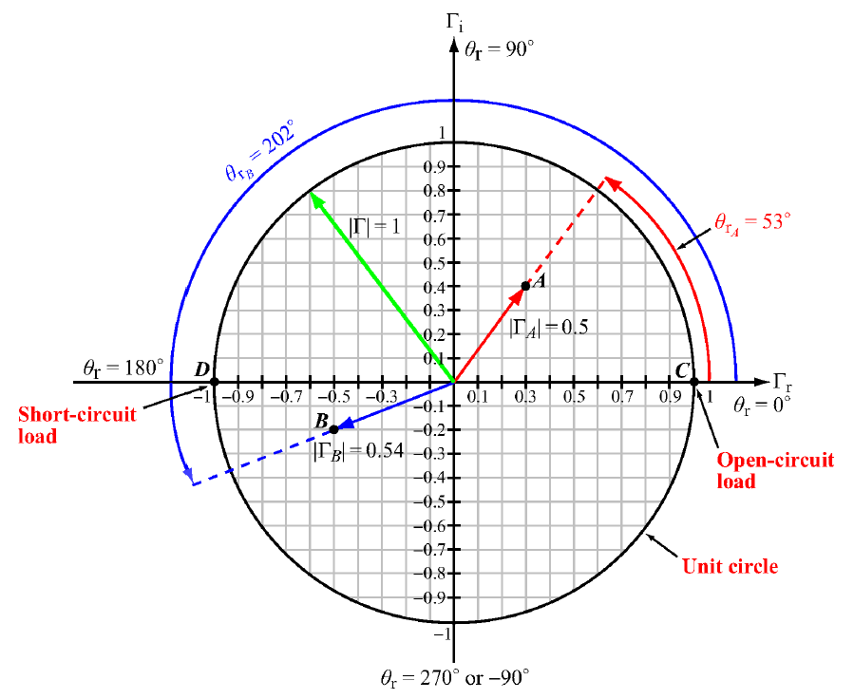
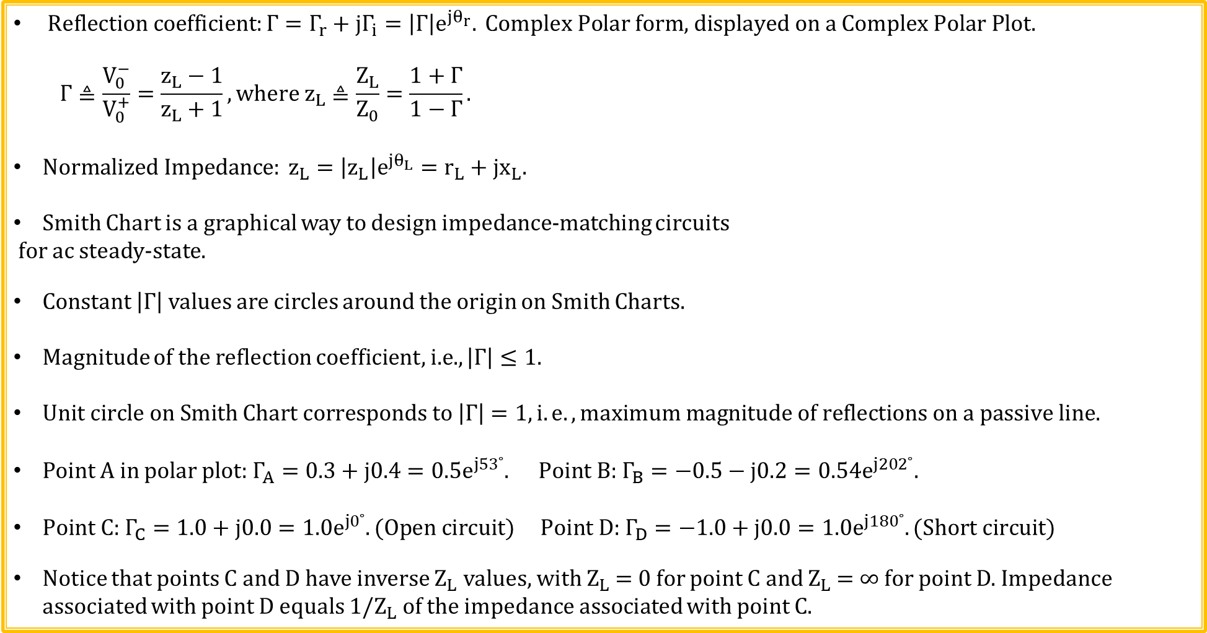
Voltage Reflection Coefficients Plane
$Reflection coefficient:Γ=Γ_{r}+jΓ_{i}=\left|Γ\right|e^{jθ_{r}}. \text{Complex} \text{Polar} \text{form}\text{, }\text{displayed} \text{on} \text{a} \text{Complex} \text{Polar} \text{Plot}\text{.}$
$$Γ≜\frac{V_{0}^{−}}{V_{0}^{+}}=\frac{z_{L}−1}{z_{L}+1}, where z_{L}≜\frac{Z_{L}}{Z_{0}}=\frac{1+Γ}{1−Γ}.$$
$Normalized Impedance: z_{L}=\left|z_{L}\right|e^{jθ_{L}}=r_{L}+{jx}_{L}.$
Smith Chart is a graphical way to design impedance-matching circuits
for ac steady-state.
Constant $\left|Γ\right|$ values are circles around the origin on Smith Charts.
Magnitude of the reflection coefficient, i.e., $\left|Γ\right|≤1.$
$Unit circle on Smith Chart corresponds to \left|Γ\right|=1, i.e. ,maximum magnitude of reflections on a passive line.$
Point A in polar plot: $Γ_{A}=0.3+j0.4=0.5e^{j53˚}. \text{Point} \text{B}\text{: }Γ_{B}=−0.5−j0.2=0.54e^{j202˚}.$
$\text{Point} \text{C}\text{:} Γ_{C}=1.0+j0.0=1.0e^{j0˚}. (Open circuit) \text{Point} \text{D}\text{: }Γ_{D}=−1.0+j0.0=1.0e^{j180˚}. (Short circuit)$
Notice that points C and D have inverse $Z_{L}$ values, with $Z_{L}$ = 0 for point C and $Z_{L}$ = ∞ for point D. Impedance associated with point D equals 1/$Z_{L}$ of the impedance associated with point C.

Slide 4
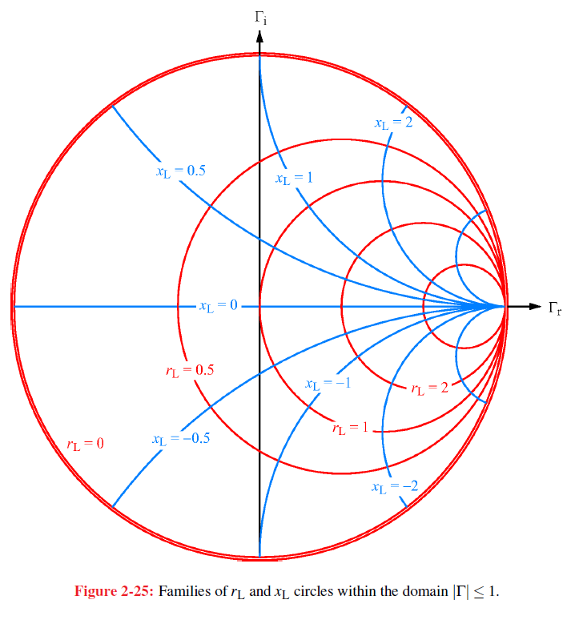
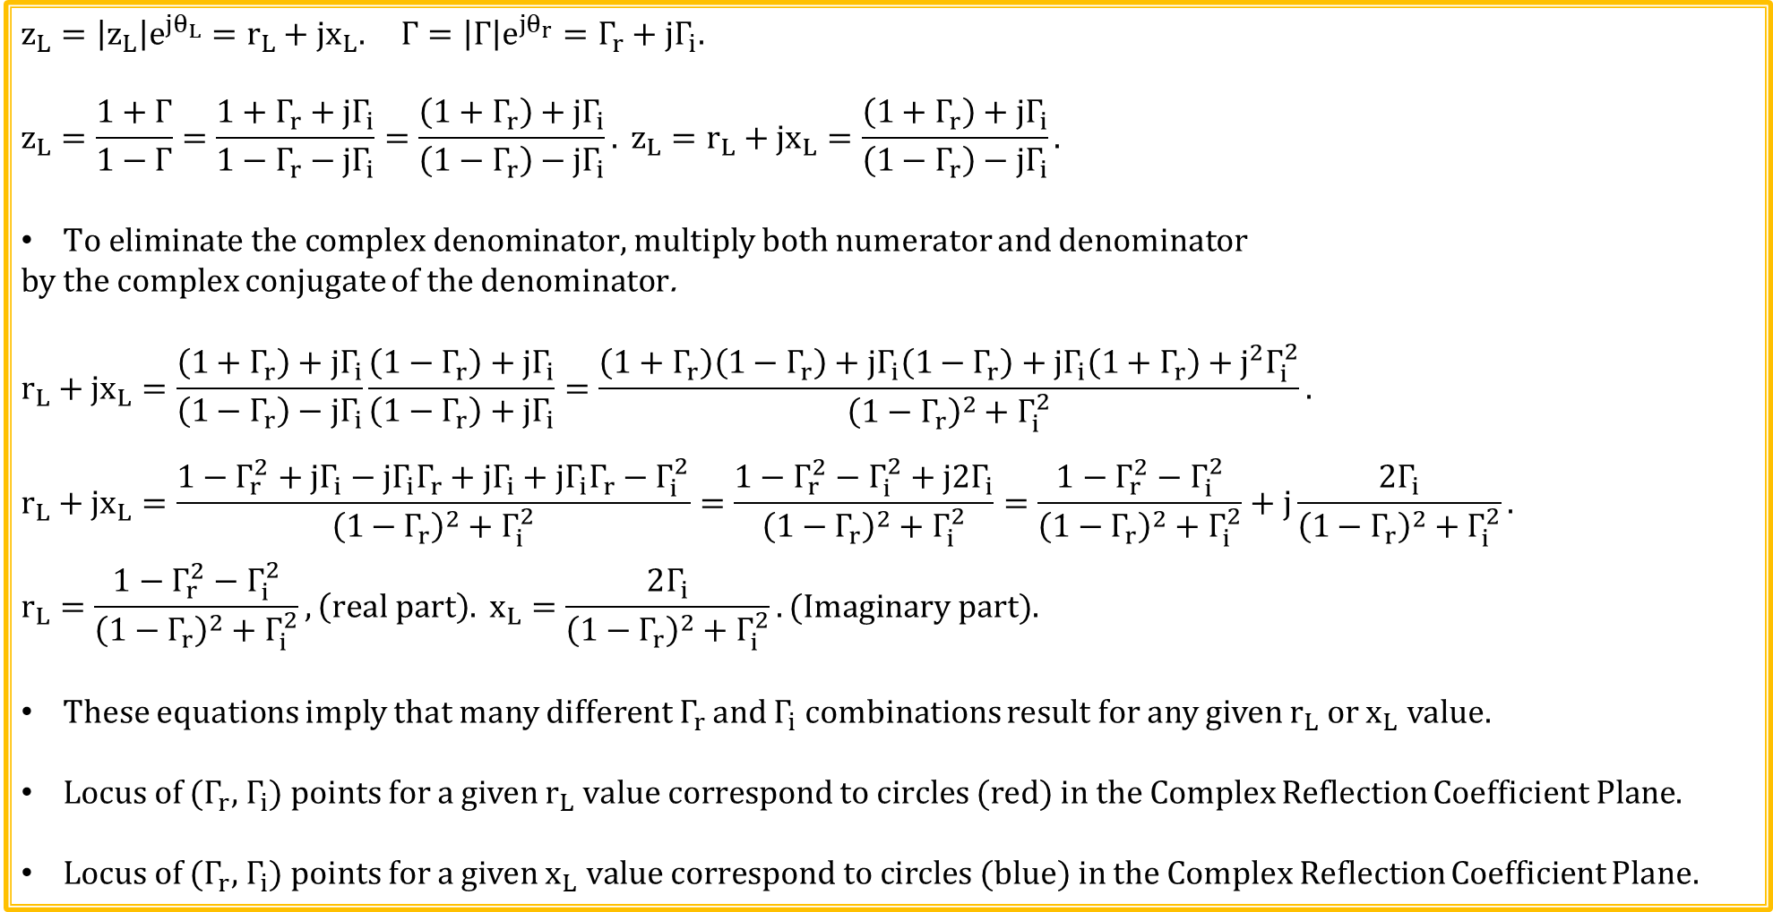
Smith Charts (Continued)
$$z_{L}=\left|z_{L}\right|e^{jθ_{L}}=r_{L}+{jx}_{L}. Γ=\left|Γ\right|e^{jθ_{r}}=Γ_{r}+{jΓ}_{i}.$$
$$z_{L}=\frac{1+Γ}{1−Γ}=\frac{1+Γ_{r}+{jΓ}_{i}}{1−Γ_{r}−{jΓ}_{i}}=\frac{\left(1+Γ_{r}\right)+{jΓ}_{i}}{\left(1−Γ_{r}\right)−{jΓ}_{i}}. z_{L}=r_{L}+{jx}_{L}=\frac{\left(1+Γ_{r}\right)+{jΓ}_{i}}{\left(1−Γ_{r}\right)−{jΓ}_{i}}.$$
$To eliminate the complex denominator,$ multiply both numerator and denominator
by the complex conjugate of the denominator.
$$r_{L}+{jx}_{L}=\frac{\left(1+Γ_{r}\right)+jΓ_{i}}{\left(1−Γ_{r}\right)−{jΓ}_{i}}\frac{\left(1−Γ_{r}\right)+jΓ_{i}}{\left(1−Γ_{r}\right)+{jΓ}_{i}}=\frac{\left(1+Γ_{r}\right)\left(1−Γ_{r}\right)+jΓ_{i}\left(1−Γ_{r}\right)+jΓ_{i}\left(1+Γ_{r}\right)+j^{2}Γ_{i}^{2}}{{\left(1−Γ_{r}\right)}^{2}+Γ_{i}^{2}}.$$
$$r_{L}+{jx}_{L}=\frac{1−Γ_{r}^{2}+jΓ_{i}−jΓ_{i}Γ_{r}+jΓ_{i}+jΓ_{i}Γ_{r}−Γ_{i}^{2}}{{\left(1−Γ_{r}\right)}^{2}+Γ_{i}^{2}}=\frac{1−Γ_{r}^{2}−Γ_{i}^{2}+j2Γ_{i}}{{\left(1−Γ_{r}\right)}^{2}+Γ_{i}^{2}}=\frac{1−Γ_{r}^{2}−Γ_{i}^{2}}{{\left(1−Γ_{r}\right)}^{2}+Γ_{i}^{2}}+j\frac{2Γ_{i}}{{\left(1−Γ_{r}\right)}^{2}+Γ_{i}^{2}}.$$
$$r_{L}=\frac{1−Γ_{r}^{2}−Γ_{i}^{2}}{{\left(1−Γ_{r}\right)}^{2}+Γ_{i}^{2}}, \left(real part\right). x_{L}=\frac{2Γ_{i}}{{\left(1−Γ_{r}\right)}^{2}+Γ_{i}^{2}}. (Imaginary part).$$
These equations imply that many different $Γ_{r}$ and $Γ_{i}$ combinations result for any given $r_{L}$ or $x_{L}$ value.
Locus of ($Γ_{r}$, $Γ_{i}$) points for a given $r_{L} value correspond to circles$ (red) in the Complex Reflection Coefficient Plane.
Locus of ($Γ_{r}$, $Γ_{i}$) points for a given $x_{L} value correspond to circles$ (blue) in the Complex Reflection Coefficient Plane.

Slide 5
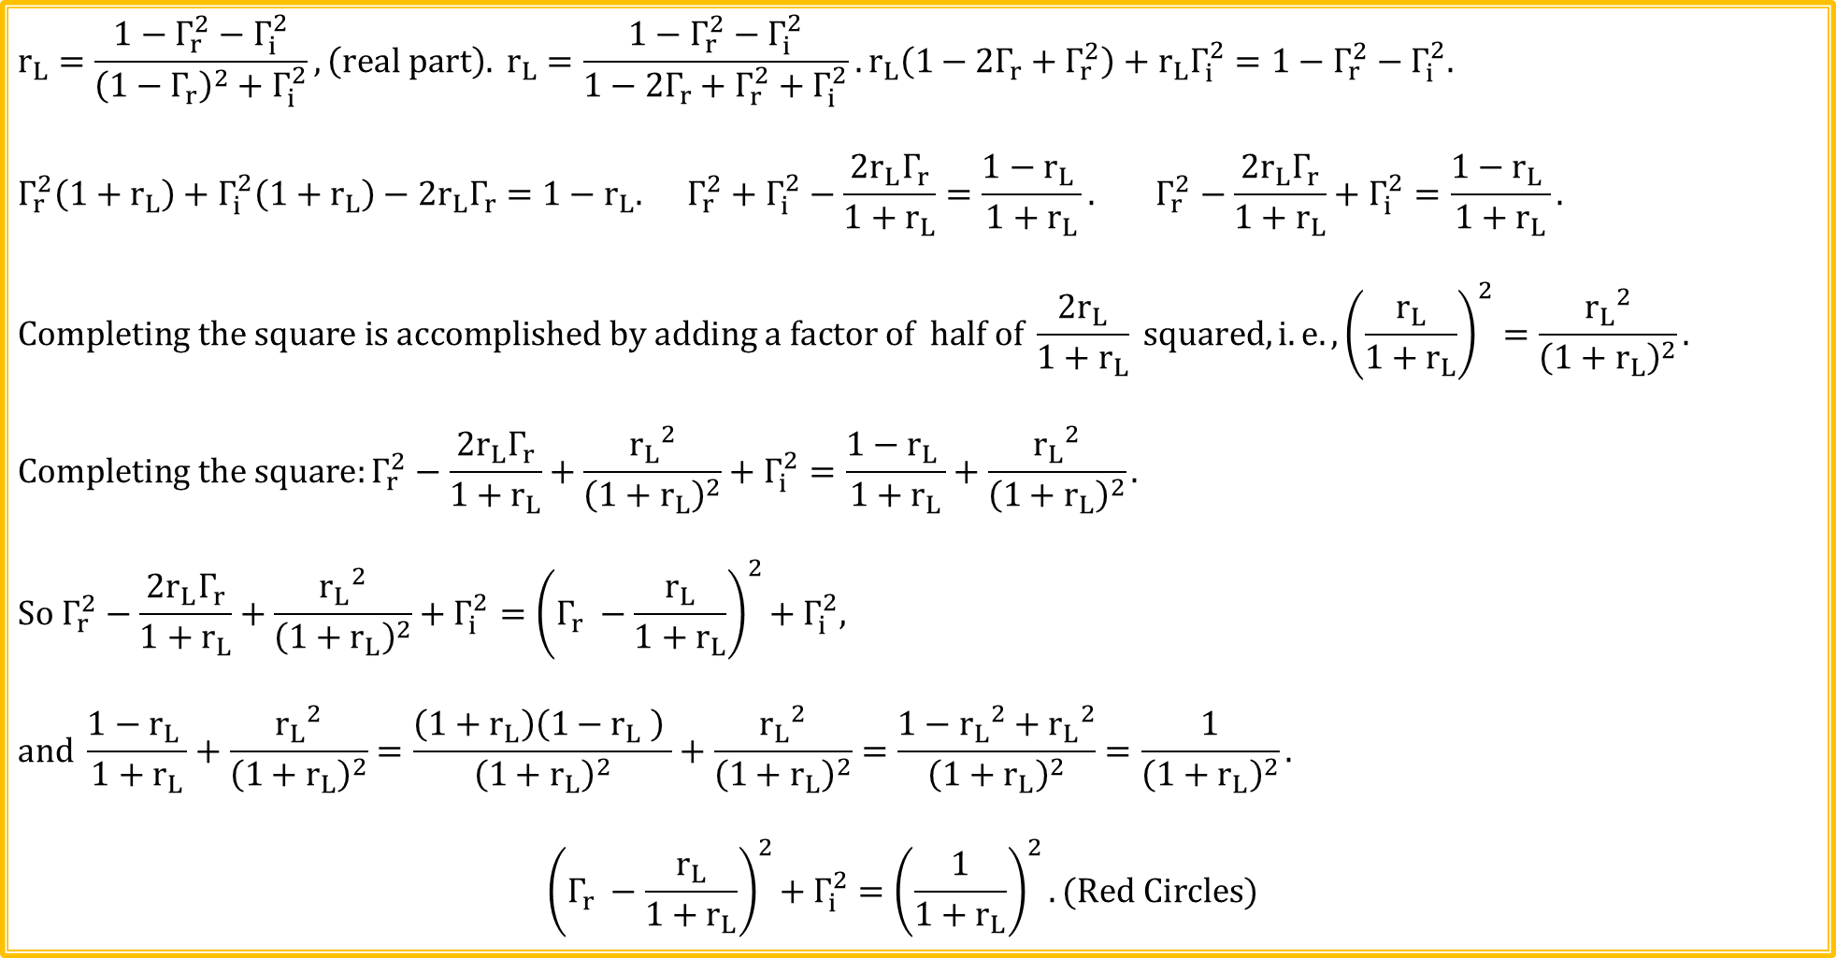
Smith Charts (Continued)
$$r_{L}=\frac{1−Γ_{r}^{2}−Γ_{i}^{2}}{{\left(1−Γ_{r}\right)}^{2}+Γ_{i}^{2}}, \left(real part\right). r_{L}=\frac{1−Γ_{r}^{2}−Γ_{i}^{2}}{1−2Γ_{r}+Γ_{r}^{2}+Γ_{i}^{2}}. r_{L}\left(1−2Γ_{r}+Γ_{r}^{2}\right)+r_{L}Γ_{i}^{2}=1−Γ_{r}^{2}−Γ_{i}^{2}.$$
$$Γ_{r}^{2}\left(1+r_{L}\right)+Γ_{i}^{2}\left(1+r_{L}\right)−2r_{L}Γ_{r}=1−r_{L}. Γ_{r}^{2}+Γ_{i}^{2}−\frac{2r_{L}Γ_{r}}{1+r_{L}}=\frac{1−r_{L} }{1+r_{L}}. Γ_{r}^{2}−\frac{2r_{L}Γ_{r}}{1+r_{L}}+Γ_{i}^{2}=\frac{1−r_{L} }{1+r_{L}}.$$
$$Completing the square is accomplished by adding a factor of half of \frac{2r_{L}}{1+r_{L}} squared, i.e., {\left(\frac{r_{L}}{1+r_{L}}\right)}^{2}=\frac{{r_{L}}^{2}}{{\left(1+r_{L}\right)}^{2}}.$$
$$Completing the square:Γ_{r}^{2}−\frac{2r_{L}Γ_{r}}{1+r_{L}}+\frac{{r_{L}}^{2}}{{\left(1+r_{L}\right)}^{2}}+Γ_{i}^{2}=\frac{1−r_{L} }{1+r_{L}}+\frac{{r_{L}}^{2}}{{\left(1+r_{L}\right)}^{2}}.$$
$${So Γ_{r}^{2}−\frac{2r_{L}Γ_{r}}{1+r_{L}}+\frac{{r_{L}}^{2}}{{\left(1+r_{L}\right)}^{2}}+Γ_{i}^{2}=\left(Γ_{r} −\frac{r_{L}}{1+r_{L}}\right)}^{2}{+ Γ}_{i}^{2},$$
$$and \frac{1−r_{L} }{1+r_{L}}+\frac{{r_{L}}^{2}}{{\left(1+r_{L}\right)}^{2}}=\frac{\left(1+r_{L}\right)\left(1−r_{L} \right) }{{\left(1+r_{L}\right)}^{2}}+\frac{{r_{L}}^{2}}{{\left(1+r_{L}\right)}^{2}}=\frac{1−{r_{L}}^{2}+{r_{L}}^{2}}{{\left(1+r_{L}\right)}^{2}}=\frac{1}{{\left(1+r_{L}\right)}^{2}}.$$
$${\left(Γ_{r} −\frac{r_{L}}{1+r_{L}}\right)}^{2}{+ Γ}_{i}^{2} ={\left(\frac{1}{1+r_{L}}\right)}^{2}. (Red Circles)$$

Slide 6
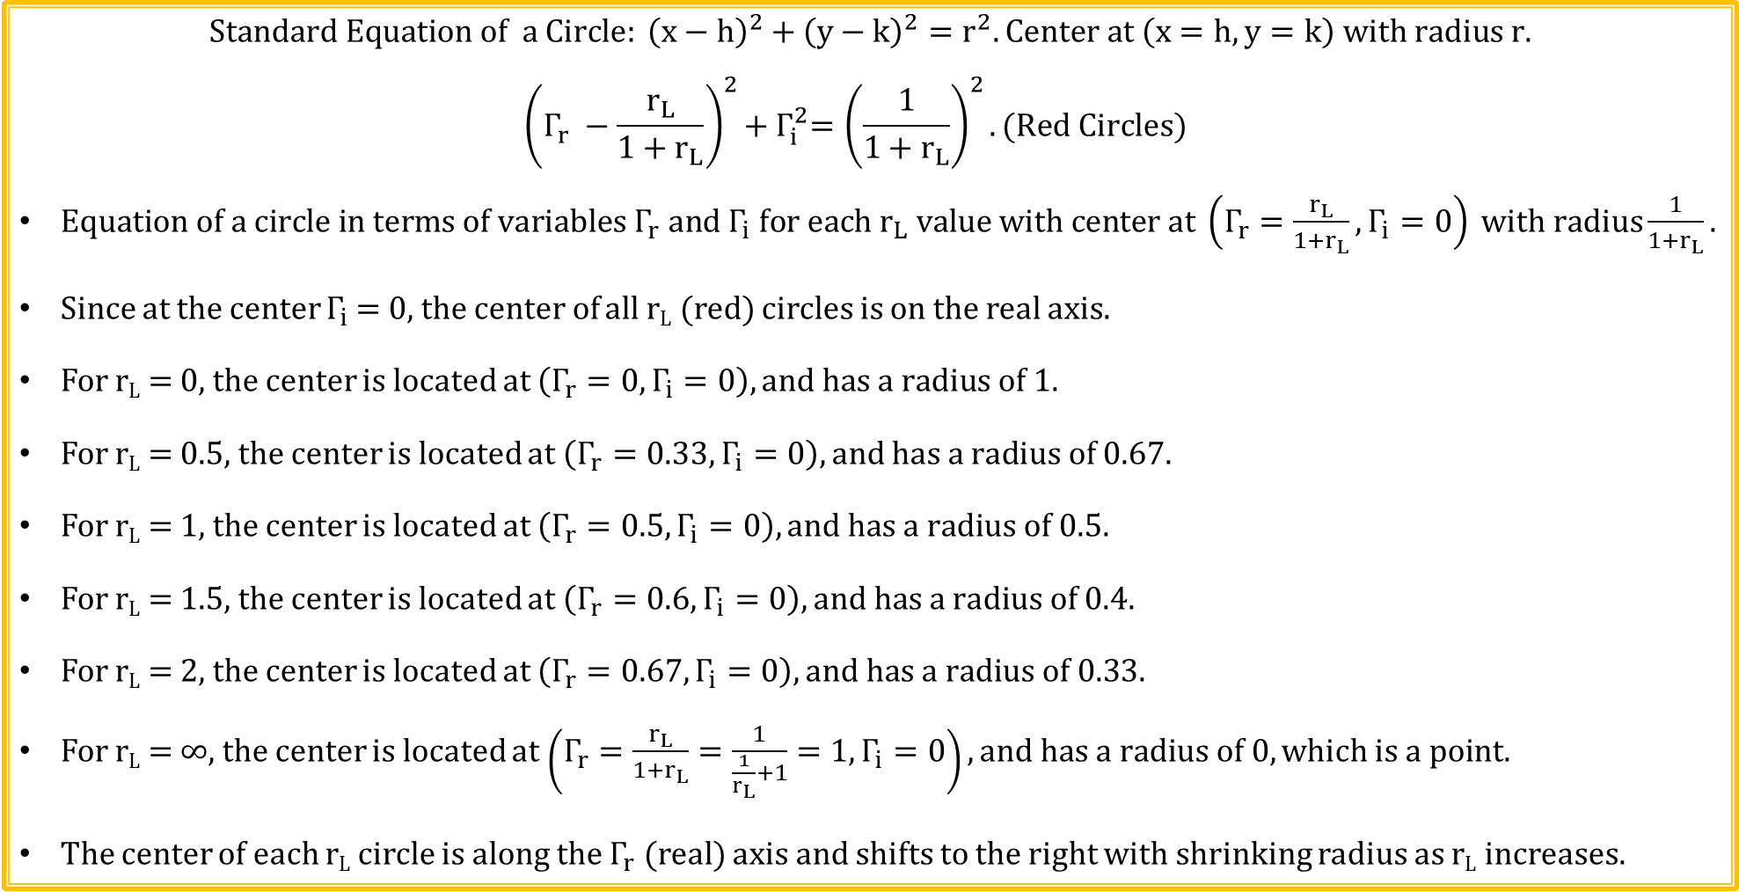
Smith Charts (Continued)
$$Standard Equation of a Circle: {\left(x−h\right)}^{2}+{\left(y−k\right)}^{2}=r^{2}. Center at \left(x=h, y=k\right) with radius r.$$
$${\left(Γ_{r} −\frac{r_{L}}{1+r_{L}}\right)}^{2}{+ Γ}_{i}^{2}={\left(\frac{1}{1+r_{L}}\right)}^{2}. (Red Circles)$$
$Equation of a circle in terms of variables Γ_{r} and Γ_{i} for each r_{L} value with center at \left(Γ_{r}=\frac{r_{L}}{1+r_{L}},Γ_{i}=0\right) with radius\frac{1}{1+r_{L}}.$
Since at the center $Γ_{i}$ = 0, the center of all r_{L} (red) circles is on the real axis.
For r_{L} = 0, the center is located at $\left(Γ_{r}=0,Γ_{i}=0\right), and has a radius of 1.$
For r_{L} = 0.5, the center is located at $\left(Γ_{r}=0.33,Γ_{i}=0\right), and has a radius of 0.67.$
For r_{L} = 1, the center is located at $\left(Γ_{r}=0.5,Γ_{i}=0\right), and has a radius of 0.5.$
For r_{L} = 1.5, the center is located at $\left(Γ_{r}=0.6,Γ_{i}=0\right), and has a radius of 0.4.$
For r_{L} = 2, the center is located at $\left(Γ_{r}=0.67,Γ_{i}=0\right), and has a radius of 0.33.$
For r_{L} = ∞, the center is located at $\left(Γ_{r}=\frac{r_{L}}{1+r_{L}}=\frac{1}{\frac{1}{r_{L}}+1}=1,Γ_{i}=0\right), and has a radius of 0, which is a point.$
The center of each r_{L} circle is along the $Γ_{r}$ (real) axis and shifts to the right with shrinking radius as r_{L} increases.

Slide 7
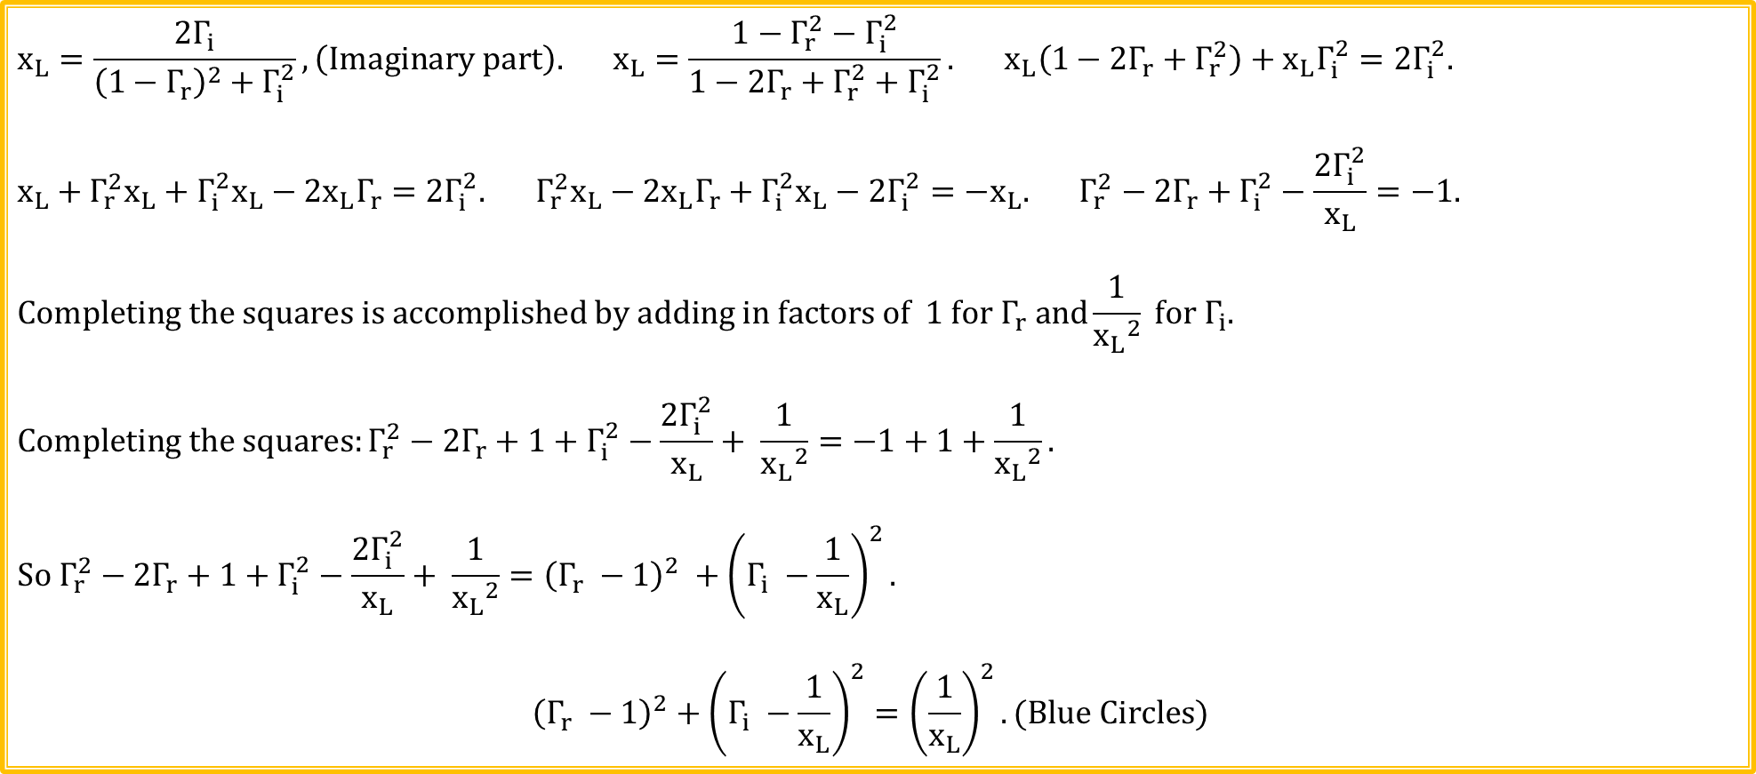
Smith Charts (Continued)
$$x_{L}=\frac{2Γ_{i}}{{\left(1−Γ_{r}\right)}^{2}+Γ_{i}^{2}}, \left(Imaginary part\right). x_{L}=\frac{1−Γ_{r}^{2}−Γ_{i}^{2}}{1−2Γ_{r}+Γ_{r}^{2}+Γ_{i}^{2}}. x_{L}\left(1−2Γ_{r}+Γ_{r}^{2}\right)+x_{L}Γ_{i}^{2}=2Γ_{i}^{2}.$$
$$x_{L}+Γ_{r}^{2}x_{L}+Γ_{i}^{2}x_{L}−2x_{L}Γ_{r}=2Γ_{i}^{2}. Γ_{r}^{2}x_{L}−2x_{L}Γ_{r}+Γ_{i}^{2}x_{L}−2Γ_{i}^{2}={−x}_{L}. Γ_{r}^{2}−2Γ_{r}+Γ_{i}^{2}−\frac{2Γ_{i}^{2}}{x_{L}}=−1.$$
$$Completing the squares is accomplished by adding in factors of 1 for Γ_{r} and\frac{1}{{x_{L}}^{2}} for Γ_{i}.$$
$$Completing the squares:Γ_{r}^{2}−2Γ_{r}+1+Γ_{i}^{2}−\frac{2Γ_{i}^{2}}{x_{L}}+ \frac{1}{{x_{L}}^{2}}=−1+1+\frac{1}{{x_{L}}^{2}}.$$
$${So Γ_{r}^{2}−2Γ_{r}+1+Γ_{i}^{2}−\frac{2Γ_{i}^{2}}{x_{L}}+ \frac{1}{{x_{L}}^{2}}=\left(Γ_{r} −1\right)}^{2} +{\left(Γ_{i} −\frac{1}{x_{L}}\right)}^{2}.$$
$${\left(Γ_{r} −1\right)}^{2}+{\left(Γ_{i} −\frac{1}{x_{L}}\right)}^{2}={\left(\frac{1}{x_{L}}\right)}^{2}.(Blue Circles)$$

Slide 8
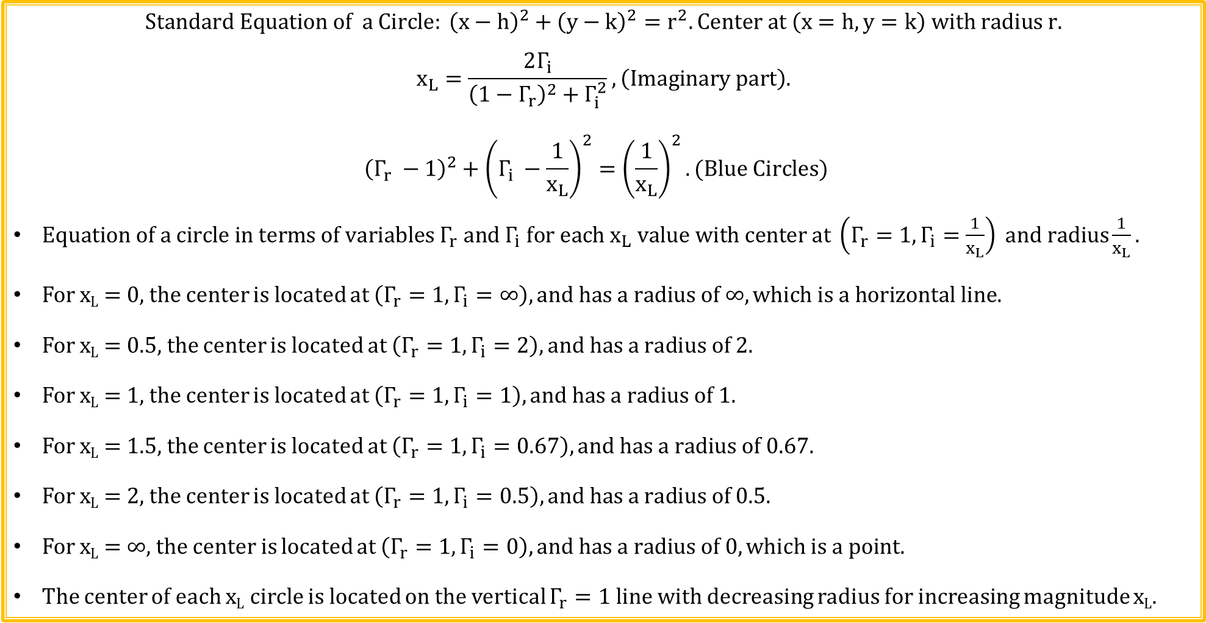

Smith Charts (Continued)
$$Standard Equation of a Circle: {\left(x−h\right)}^{2}+{\left(y−k\right)}^{2}=r^{2}. Center at \left(x=h, y=k\right) with radius r.$$
$$x_{L}=\frac{2Γ_{i}}{{\left(1−Γ_{r}\right)}^{2}+Γ_{i}^{2}}, \left(Imaginary part\right).$$
$${\left(Γ_{r} −1\right)}^{2}+{\left(Γ_{i} −\frac{1}{x_{L}}\right)}^{2}={\left(\frac{1}{x_{L}}\right)}^{2}. (Blue Circles)$$
$Equation of a circle in terms of variables Γ_{r} and Γ_{i} for each x_{L} value with center at \left(Γ_{r}=1,Γ_{i}=\frac{1}{x_{L}}\right) and radius\frac{1}{x_{L}}.$
For x_{L} = 0, the center is located at $\left(Γ_{r}=1,Γ_{i}=∞\right), and has a radius of ∞, which is a horizontal line.$
For x_{L} = 0.5, the center is located at $\left(Γ_{r}=1,Γ_{i}=2\right), and has a radius of 2.$
For x_{L} = 1, the center is located at $\left(Γ_{r}=1,Γ_{i}=1\right), and has a radius of 1.$
For x_{L} = 1.5, the center is located at $\left(Γ_{r}=1,Γ_{i}=0.67\right), and has a radius of 0.67.$
For x_{L} = 2, the center is located at $\left(Γ_{r}=1,Γ_{i}=0.5\right), and has a radius of 0.5.$
For x_{L} = ∞, the center is located at $\left(Γ_{r}=1,Γ_{i}=0\right), and has a radius of 0, which is a point.$
The center of each x_{L} circle is located on the vertical $Γ_{r}=1$ line with decreasing radius for increasing magnitude x_{L}.
$$Γ_{r}=1$$
$$Line$$

Slide 9
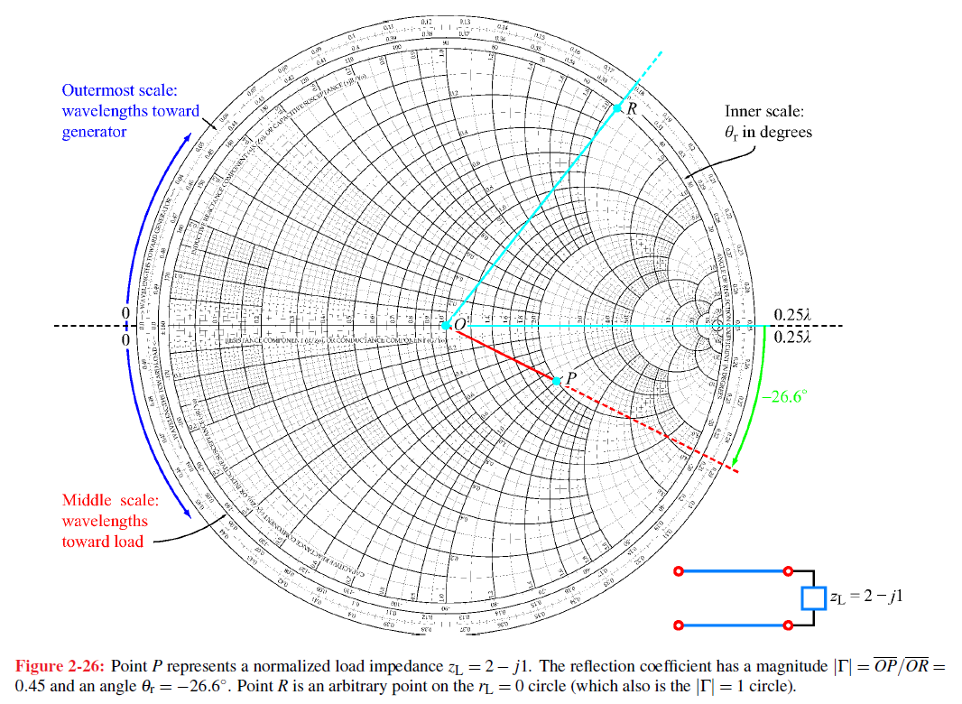
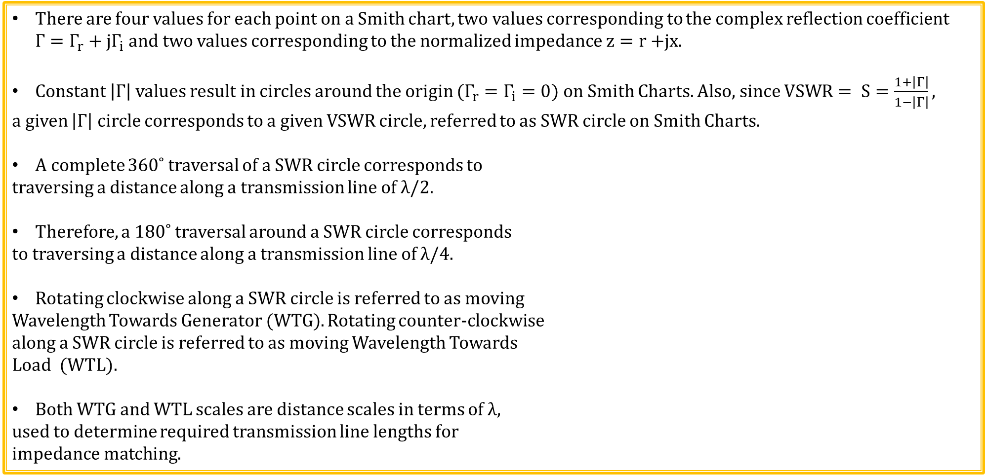
Smith Charts (Continued)
There are four values for each point on a Smith chart, two values corresponding to the complex reflection coefficient $Γ=Γ_{r}+{jΓ}_{i}$ and two values corresponding to the normalized impedance $z=r+$jx.
Constant $\left|Γ\right|$ values result in circles around the origin ($Γ_{r}=Γ_{i}=0$) on Smith Charts. Also, since $VSWR= S=\frac{1+\left|Γ\right|}{1−\left|Γ\right|},$
a given $\left|Γ\right|$ circle corresponds to a given VSWR circle, referred to as SWR circle on Smith Charts.
A complete 360˚ traversal of a SWR circle corresponds to
traversing a distance along a transmission line of λ/2.
Therefore, a 180˚ traversal around a SWR circle corresponds
to traversing a distance along a transmission line of λ/4.
Rotating clockwise along a SWR circle is referred to as moving
Wavelength Towards Generator (WTG). Rotating counter-clockwise
along a SWR circle is referred to as moving Wavelength Towards
Load (WTL).
Both WTG and WTL scales are distance scales in terms of λ,
used to determine required transmission line lengths for
impedance matching.
SWR Circle

Slide 10

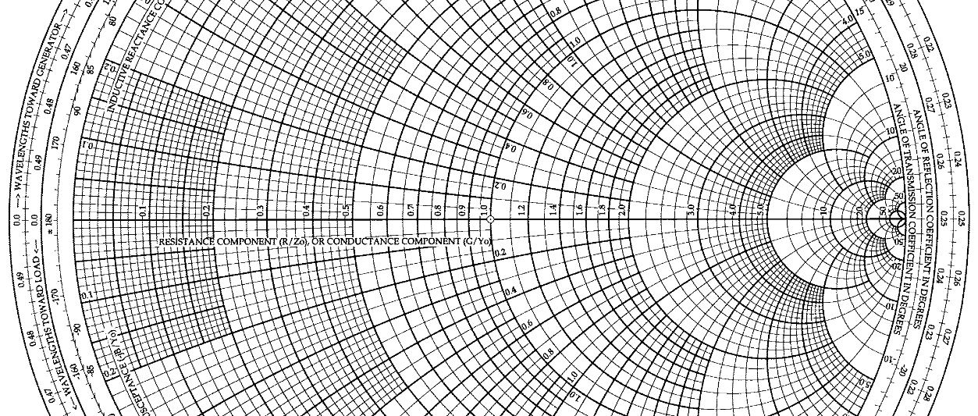
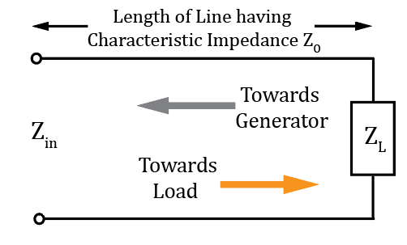
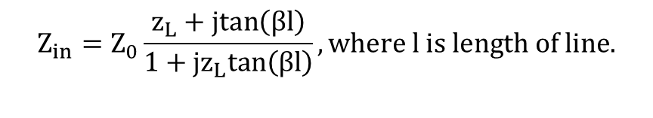


Smith Chart – WTG and WTL Outer Circles
Wavelength Toward Generator(WTG) in terms of λ.
$$Z_{in}=Z_{0}\frac{z_{L}+jtan\left(βl\right)}{1+jz_{L}tan\left(βl\right)}, where l is length of line.$$
0λ
Wavelength Toward Load (WTL) in terms of λ.

Slide 11
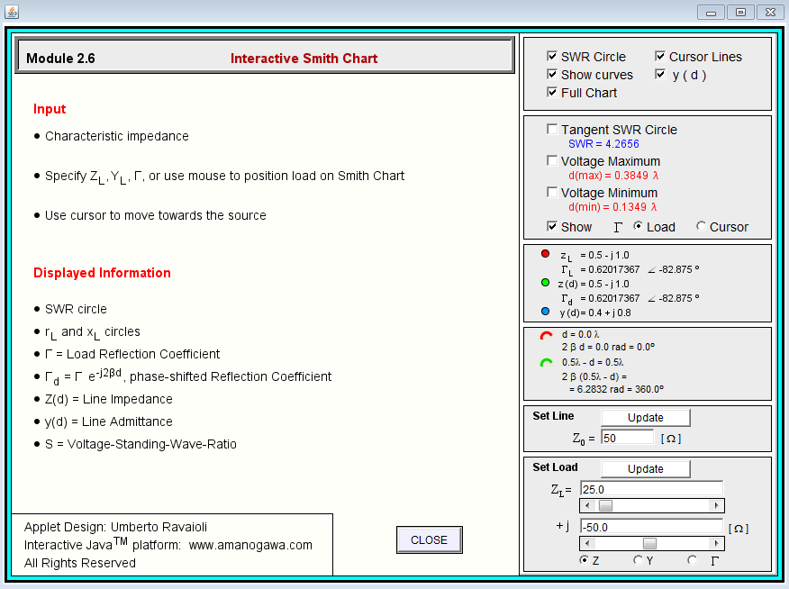
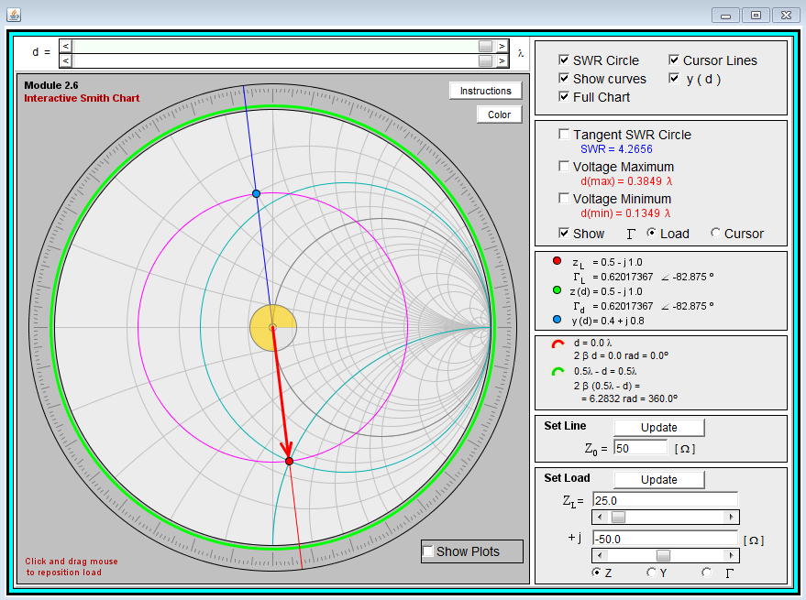
Interactive Smith Chart
Go to Applied Electromagnetics 8E Textbook Website to run the Interactive Modules, located under Student Resources. Choose module 2.6 – Interactive Smith Chart for this activity.
The Interactive Smith Chart provides Impedance and Admittance information, along with distances along the transmission line in terms of λ.
Notes:
Go to web Fundamentals of Applied Electromagnetics to download Interactive Modules available for the Ulaby – Fundamentals of Applied Electromagnetics text. Windows 10 has Java security issues that can be fixed as follows:
Java → Java Security → See Security Tab → Exception Site List. Add the following to the Exception Site List: http://em7e.eecs.umich.edu.

Slide 12
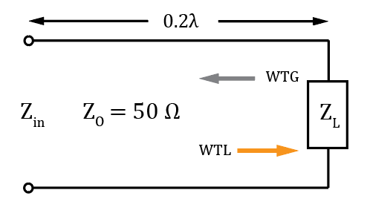
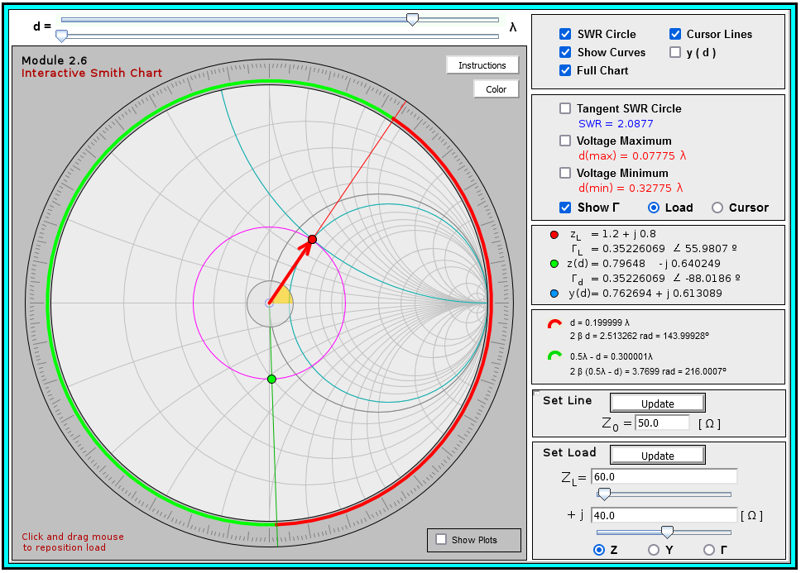
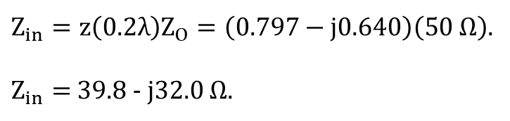

Smith Chart Example 1
Using a Smith Chart, determine Z_{in} for the adjacent circuit, given Z_{L} = 60 + j40.
WTG Slider Adjustment.
Distance d Course Slider Adjust.
Z_{L}
Distance d Fine Slider Adjust.
Left/Right Arrow Keys can also be used.
WTG
$$z\left(d=0.2λ\right)=0.797−j0.640$$
Z_{in}
d = 0.2λ towards Generator.
$Z_{in}=z\left(0.2λ\right)Z_{O}=\left(0.797−j0.640\right)\left(50 Ω\right)$.
$Z_{in}=$ 39.8 - j32.0 $Ω.$

Slide 13
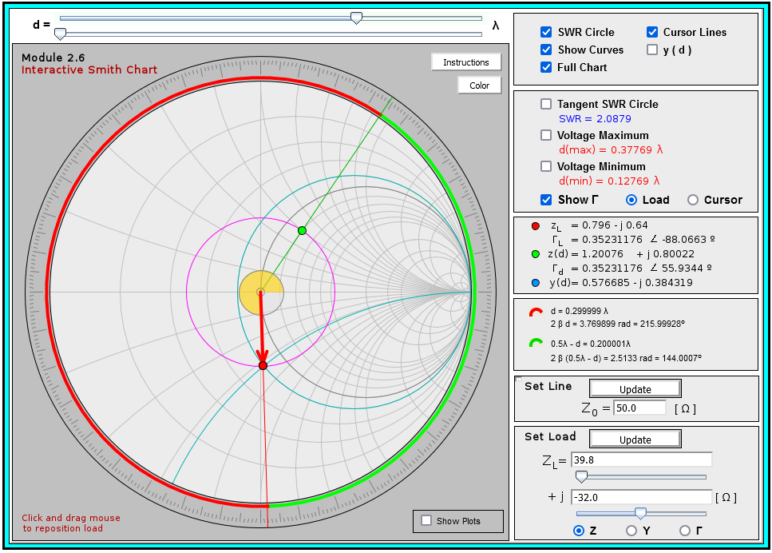

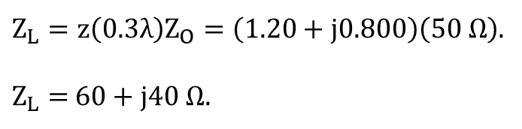

Smith Chart Example 2
Using a Smith Chart, determine Z_{L} for the adjacent circuit, given Z_{in} = 39.8 - j32.0 $Ω$.
WTG Slider Adjustment.
Left/Right Arrow Keys can also be used.
Distance d Course Adjust Slider.
Distance d Fine Adjust Slider.
0.3λ WTG
$$z\left(d=0.3λ\right)=1.20+j0.800$$
d = 0.5λ - 0.2λ = 0.3λ WTG.
0.2λ WTL
Since slider only goes WTG, move slider to 0.5λ - 0.2λ = 0.3λ WTG to achieve 0.2λ WTL.
$Z_{L}=z\left(0.3λ\right)Z_{O}=\left(1.20+j0.800\right)\left(50 Ω\right)$.
$Z_{L}=$ 60 + j40 $Ω.$
Poll Questions

Slide 14

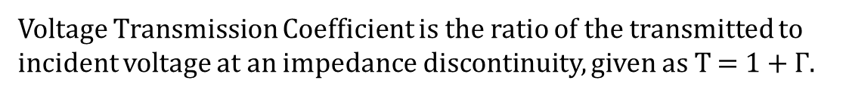

Smith Chart – Angle of Reflection Coefficient
Angle of Reflection Coefficient in Degrees
±180˚
0˚
Voltage Transmission Coefficient is the ratio of the transmitted to incident voltage at an impedance discontinuity, given as T = 1 + $Γ$.
Angle of Transmission Coefficient in Degrees

Slide 15
Smith Chart – Origin and Real Γ_{r} Axis
Origin on the Smith Chart: $z=1+j0 corresponding to Γ=0+j0=0e^{j0}=0∠0.$
Real Reflection coefficient Axis $Γ_{r}$ on a Smith Chart is marked with normalized r values with r = 1 at the origin, i.e., $z=1+j0$. r < 1 to the left of the origin and r > 1 to the right of the origin.

Slide 16
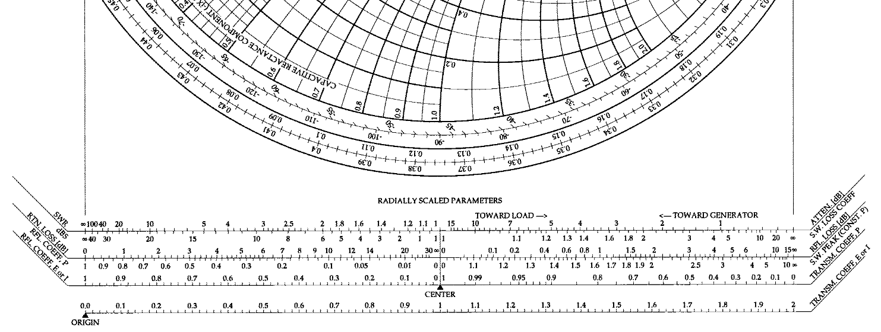


Smith Chart – Horizontal Scales
Mark the distance from the origin ($Γ=$ 0 + j0) to a Reflection Coefficient Point and then determine the magnitude from the Reflection Coeffient Magnitude E or I scale shown above.
Reflection Coefficient Magnitude E or I
Increasing Reflection Coefficient Magnitude
CENTER (0 distance reference) for Reflection Coefficient Magnitude ranging from 0 to 1.

Slide 17
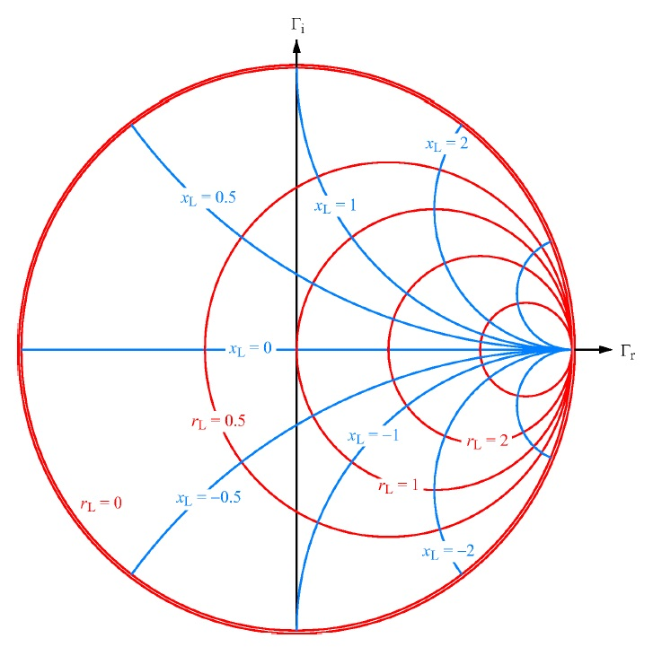
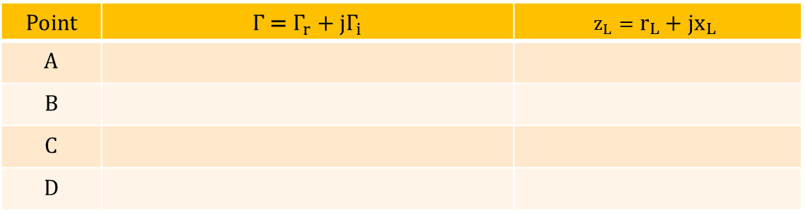
Smith Charts (Continued)
$${Γ=Γ_{r}+{jΓ}_{i}=\frac{z_{L}−1}{z_{L}+1}. z}_{L}=r_{L}+{jx}_{L}=\frac{1+Γ}{1−Γ}. Smith Chart graphically represents these relationships.$$
Point | $Γ$ =$Γ_{r}+{jΓ}_{i}$ | $$z_{L}=r_{L}+{jx}_{L}$$
A
B
C
D
0 + j0 ↔ 0$∠0°$ 1 + j0 (matched)
-1 + j0 ↔ 1$∠\left(−180°\right)$ 0 + j0 (short)
C
B
A
1 + j0 ↔ 1$∠0°$ ∞ + j0 (open)
0.52 – j0.64 ↔ 0.825$∠\left(−50.9°\right)$ 0.5 – j2 (capacitive)
D

Slide 18
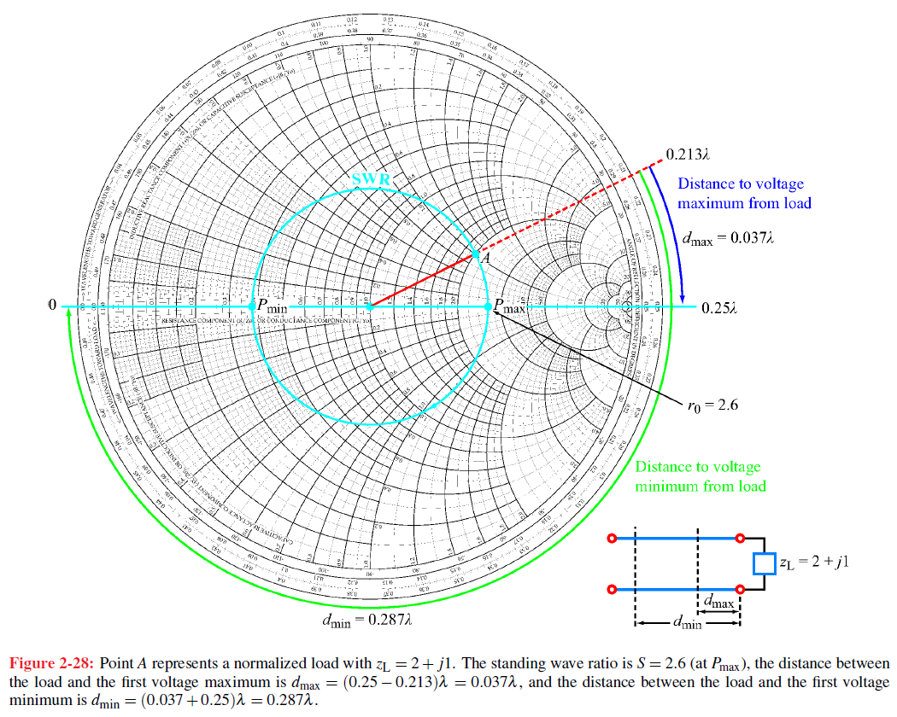
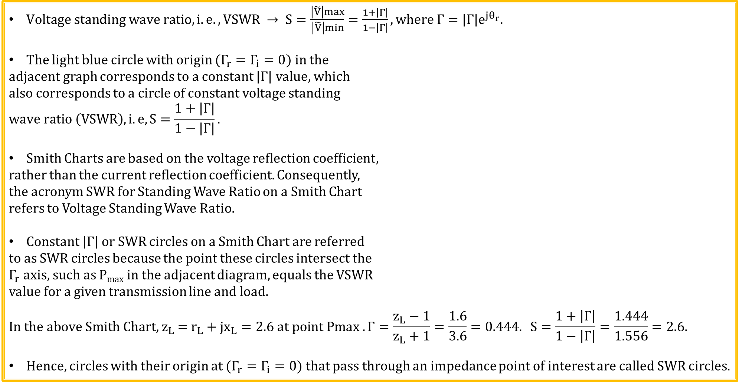
SWR Circles
$Voltage standing wave ratio, i.e., VSWR → S=\frac{\left|\tilde{V}\right|max}{\left|\tilde{V}\right|min}=\frac{1+\left|Γ\right|}{1−\left|Γ\right|}, where Γ=\left|Γ\right|e^{jθ_{r}}.$
The light blue circle with origin ($Γ_{r}=Γ_{i}=0$) in the
adjacent graph corresponds to a constant $\left|Γ\right|$ value, which
also corresponds to a circle of constant voltage standing
$$wave ratio \left(VSWR\right), i.e, S=\frac{1+\left|Γ\right|}{1−\left|Γ\right|}.$$
Smith Charts are based on the voltage reflection coefficient,
rather than the current reflection coefficient. Consequently,
the acronym SWR for Standing Wave Ratio on a Smith Chart
refers to Voltage Standing Wave Ratio.
Constant $\left|Γ\right|$ or SWR circles on a Smith Chart are referred
to as SWR circles because the point these circles intersect the
$Γ_{r}$ axis, such as P_{max} in the adjacent diagram, equals the VSWR
value for a given transmission line and load.
$$\text{I}\text{n} \text{the} \text{above} Smith Chart\text{, }z_{L} \text{= }r_{L}+{jx}_{L}=2.6 \text{at} \text{point} \text{Pmax} . Γ=\frac{z_{L}−1}{z_{L}+1}=\frac{1.6}{3.6}=0.444. S=\frac{1+\left|Γ\right|}{1−\left|Γ\right|}=\frac{1.444}{1.556}=2.6.$$
Hence, circles with their origin at ($Γ_{r}=Γ_{i}=0$) that pass through an impedance point of interest are called SWR circles.

Slide 19
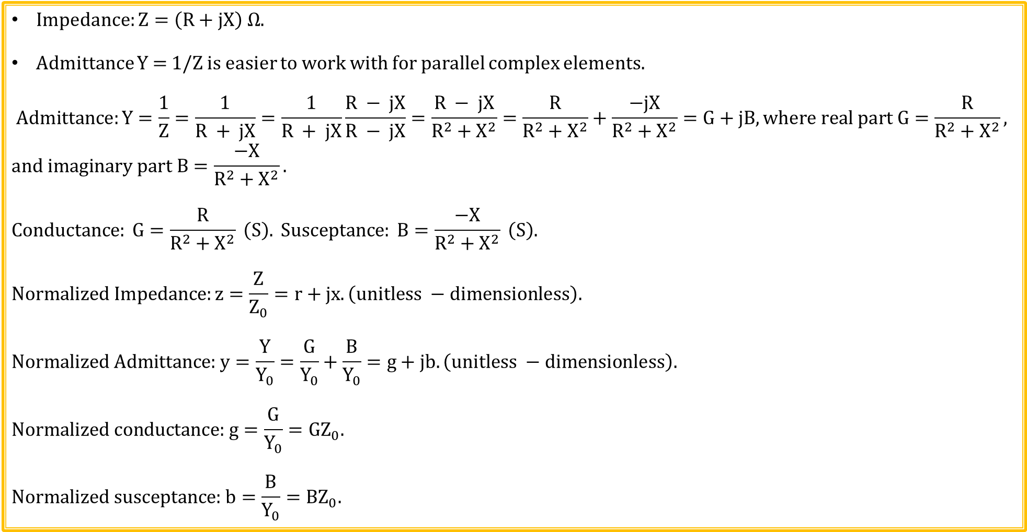
Impedance and Admittance Transformations
Impedance: $Z=\left(R+jX\right) Ω.$
Admittance Y = 1/Z is easier to work with for parallel complex elements.
$$Admittance:Y=\frac{1}{Z}=\frac{1}{R + jX}=\frac{1}{R + jX}\frac{R − jX}{R − jX}=\frac{R − jX}{R^{2}+{ X}^{2}}=\frac{R}{R^{2}+{ X}^{2}}+\frac{−jX}{R^{2}+{ X}^{2}}=G+jB, where real part G=\frac{R}{R^{2}+{ X}^{2}},$$
$$and imaginary part B=\frac{−X}{R^{2}+{ X}^{2}}.$$
$$Conductance: G=\frac{R}{R^{2}+{ X}^{2}} \left(S\right). Susceptance: B=\frac{−X}{R^{2}+{ X}^{2}} \left(S\right).$$
$$Normalized Impedance:z=\frac{Z}{Z_{0}}=r+jx. \left(unitless −dimensionless\right).$$
$$\text{Normalized} \text{Admittance}\text{:} y=\frac{Y}{Y_{0}}=\frac{G}{Y_{0}}+\frac{B}{Y_{0}}=g+jb.\left(unitless −dimensionless\right).$$
$$\text{Normalized} \text{conductance}\text{:} g=\frac{G}{Y_{0}}=GZ_{0}.$$
$$\text{Normalized} \text{susceptance}\text{:} b=\frac{B}{Y_{0}}=BZ_{0}.$$

Slide 20
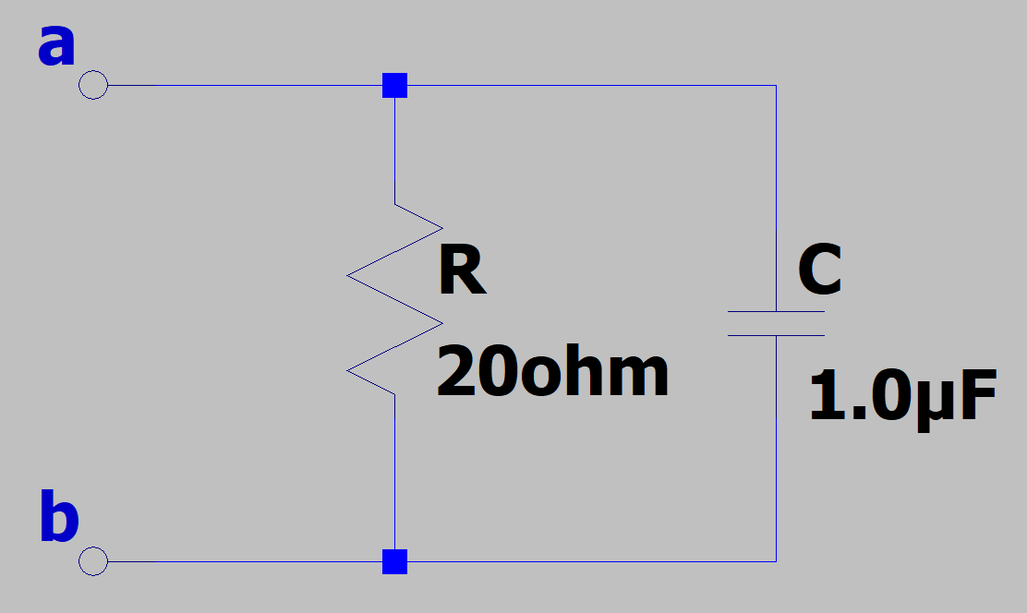
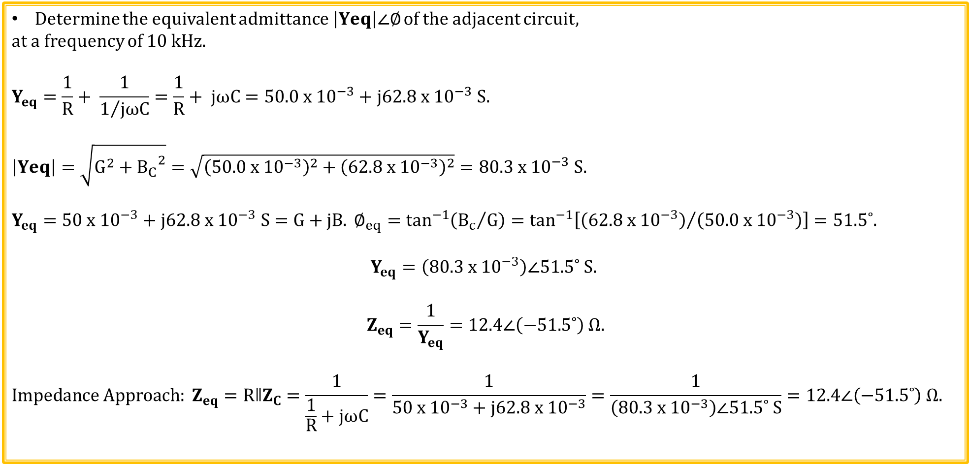
Admittance Example
Determine the equivalent admittance $\left|Yeq\right|∠∅$ of the adjacent circuit,
at a frequency of 10 kHz.
$$Y_{eq}=\frac{1}{R}+ \frac{1}{1/{jωC}}=\frac{1}{R}+ jωC=50.0 x {10}^{−3}+j62.8 x {10}^{−3} S.$$
$$\left|Yeq\right|=\sqrt{G^{2}+{B_{C}}^{2}}=\sqrt{{\left(50.0 x {10}^{−3}\right)}^{2}+{\left(62.8 x {10}^{−3}\right)}^{2}}=80.3 x {10}^{−3} S.$$
$$Y_{eq}=50 x {10}^{−3}+j62.8 x {10}^{−3} S=G+jB. ∅_{eq}=\tan^{−1}\left({B_{c}}/G\right)=\tan^{−1}\left[{\left(62.8 x {10}^{−3}\right)}/{\left(50.0 x {10}^{−3}\right)}\right]=51.5˚.$$
$$Y_{eq}=\left(80.3 x {10}^{−3}\right)∠51.5˚ S.$$
$$Z_{eq}=\frac{1}{Y_{eq}}=12.4∠\left(−51.5˚\right) Ω.$$
$$Impedance Approach: Z_{eq}=RǁZ_{C}=\frac{1}{\frac{1}{R}+jωC}=\frac{1}{50 x {10}^{−3}+j62.8 x {10}^{−3}}=\frac{1}{\left(80.3 x {10}^{−3}\right)∠51.5˚ S}=12.4∠\left(−51.5˚\right) Ω.$$

Slide 21
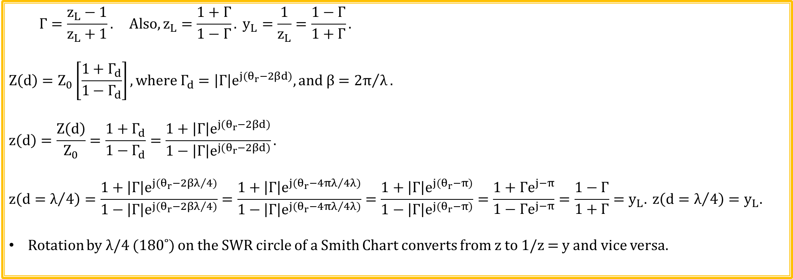
Impedance and Admittance (Continued)
$$Γ=\frac{z_{L}−1}{z_{L}+1}. Also,z_{L}=\frac{1+Γ}{1−Γ}. y_{L}=\frac{1}{z_{L}}=\frac{1−Γ}{1+Γ}.$$
$$Z\left(d\right)=Z_{0}\left[\frac{1+Γ_{d}}{1−Γ_{d}}\right], where Γ_{d}=\left|Γ\right|e^{j{(θ}_{r}−2βd)}, and β={2π}/λ.$$
$$z\left(d\right)=\frac{Z\left(d\right)}{Z_{0}}=\frac{1+Γ_{d}}{1−Γ_{d}}=\frac{1+\left|Γ\right|e^{j{(θ}_{r}−2βd)}}{1−\left|Γ\right|e^{j{(θ}_{r}−2βd)}}.$$
$$z\left(d=λ/4\right)=\frac{1+\left|Γ\right|e^{j{(θ}_{r}−2βλ/4)}}{1−\left|Γ\right|e^{j{(θ}_{r}−2βλ/4)}}=\frac{1+\left|Γ\right|e^{j{(θ}_{r}−4πλ/{4λ})}}{1−\left|Γ\right|e^{j{(θ}_{r}−4πλ/{4λ})}}=\frac{1+\left|Γ\right|e^{j{(θ}_{r}−π)}}{1−\left|Γ\right|e^{j{(θ}_{r}−π)}}=\frac{1+{Γe}^{j−π}}{1−{Γe}^{j−π}}=\frac{1−Γ}{1+Γ}=y_{L}. z\left(d=λ/4\right)=y_{L}.$$
Rotation by λ/4 (180˚) on the SWR circle of a Smith Chart converts from z to 1/z = y and vice versa.

Slide 22
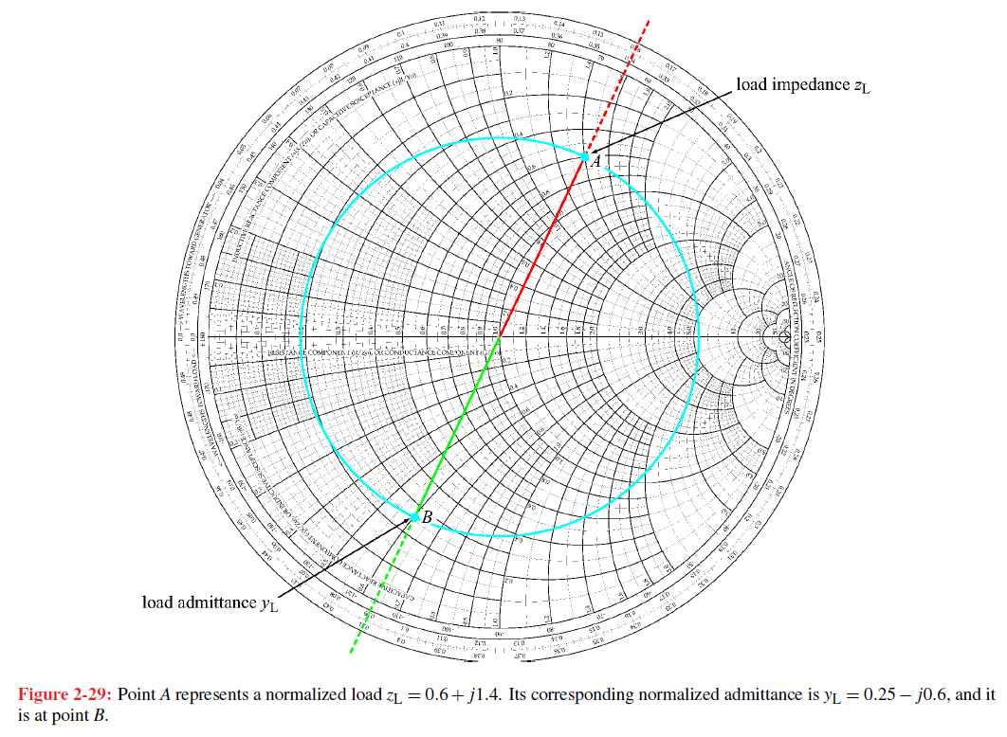

Impedance and Admittance (Continued)
Rotation by λ/4 (180˚) on the SWR circle of a Smith Chart converts from z to 1/z = y and vice versa.
Smith Chart can be used either as an impedance
or admittance chart.
When used as an admittance chart, the $r_{L} and x_{L}$
circles become $g_{L} and b_{L}$ circles.
Admittance is more convenient for parallel
(shunt) circuits.
In the adjacent Smith Chart normalized
impedance at point A represents
$z_{L}=$ 0.6 + j1.4 → 1.5232$∠67˚.$ $z_{L}^{−1}$=0.66$∠(−67˚$).
Translating to point B by λ/4 on the
constant SWR circle results in a
normalized load admittance of
$y_{L}=$ 0.25 – j0.6 → 0.65$∠(−67˚$) ≈ 1/$z_{L}$.
Can also arrive at B by drawing straight line from A through origin and intersect constant SWR circle.
Poll Questions

Slide 23
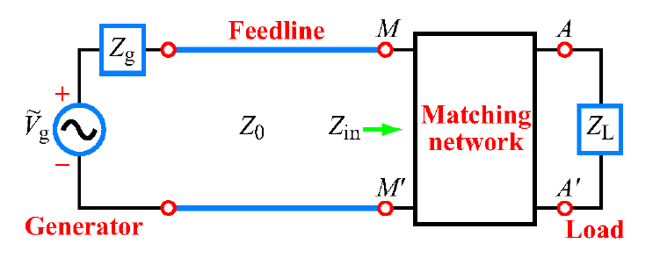
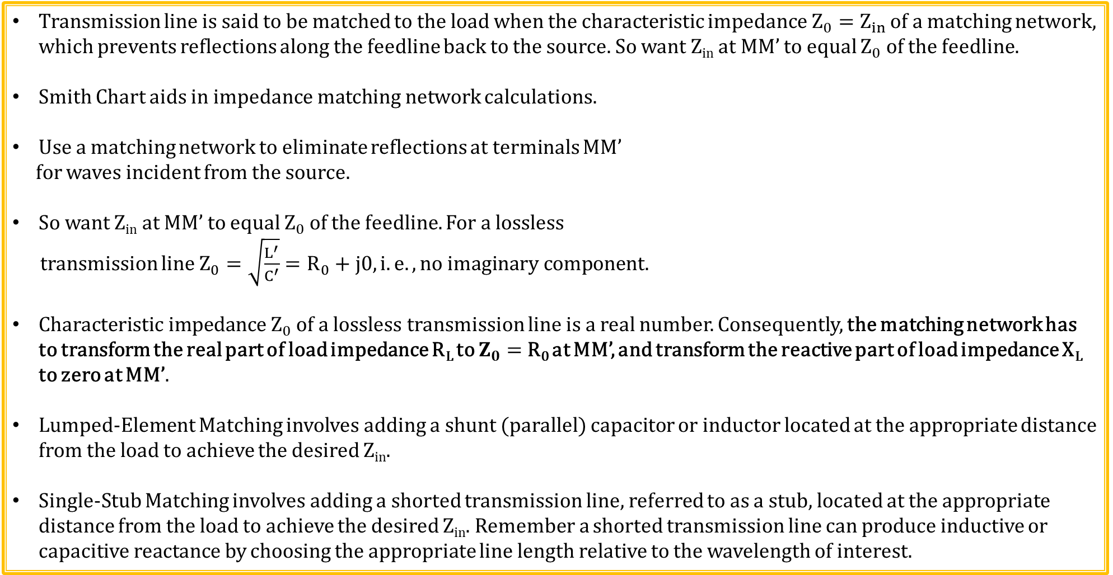
Back to Impedance Matching
Transmission line is said to be matched to the load when the characteristic impedance $Z_{0}=Z_{in}$ of a matching network, which prevents reflections along the feedline back to the source. So want Z_{in} at MM’ to equal $Z_{0}$ of the feedline.
Smith Chart aids in impedance matching network calculations.
Use a matching network to eliminate reflections at terminals MM’
for waves incident from the source.
So want Z_{in} at MM’ to equal $Z_{0}$ of the feedline. For a lossless
transmission line $Z_{0}=\sqrt{\frac{L^{′}}{C^{′}}}=R_{0}+j0, i.e. ,no imaginary component.$
$Characteristic impedance Z_{0}$ of a lossless transmission line is a real number. Consequently, the matching network has to transform the real part of load impedance R_{L} to $Z_{0}=$ R₀ at MM’, and transform the reactive part of load impedance X_{L} to zero at MM’.
Lumped-Element Matching involves adding a shunt (parallel) capacitor or inductor located at the appropriate distance from the load to achieve the desired Z_{in}.
Single-Stub Matching involves adding a shorted transmission line, referred to as a stub, located at the appropriate distance from the load to achieve the desired Z_{in}. Remember a shorted transmission line can produce inductive or capacitive reactance by choosing the appropriate line length relative to the wavelength of interest.

Slide 24
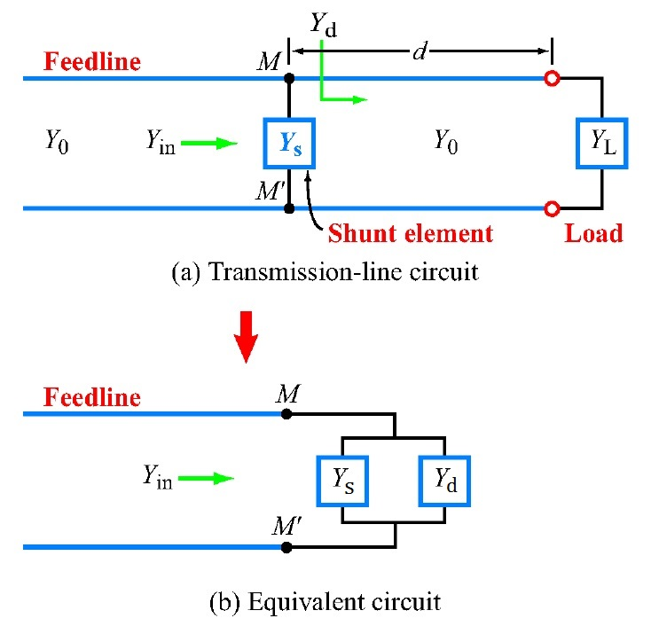
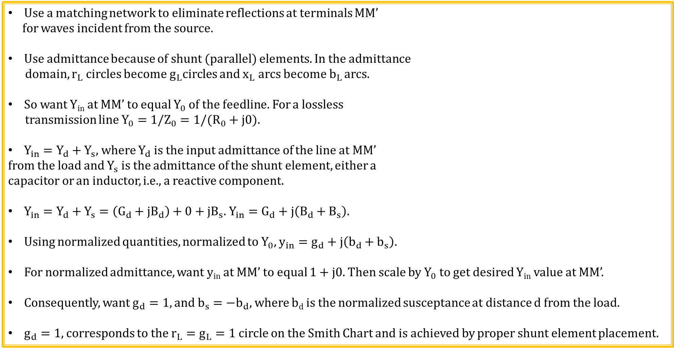
Lumped Element Matching
Use a matching network to eliminate reflections at terminals MM’
for waves incident from the source.
Use admittance because of shunt (parallel) elements. In the admittance
domain, $r_{L}$ circles become $g_{L}$circles and $x_{L}$ arcs become $b_{L}$ arcs.
So want Y_{in} at MM’ to equal $Y_{0}$ of the feedline. For a lossless
transmission line $Y_{0}={1/Z_{0}=1/(R}_{0}+j0).$
$Y_{in}=Y_{d}+Y_{s}$, where $Y_{d}$ is the input admittance of the line at MM’
from the load and $Y_{s}$ is the admittance of the shunt element, either a
capacitor or an inductor, i.e., a reactive component.
$Y_{in}=Y_{d}+Y_{s}=\left(G_{d}+jB_{d}\right)+0+jB_{s}$. $Y_{in}=G_{d}+j\left(B_{d}+B_{s}\right)$.
Using normalized quantities, normalized to $Y_{0},$ $y_{in}=g_{d}+j\left(b_{d}+b_{s}\right)$.
For normalized admittance, want y_{in} at MM’ to equal 1 + j0. Then scale by $Y_{0}$ to get desired Y_{in} value at MM’.
Consequently, want $g_{d}=1, and b_{s}={−b}_{d},$ where b_{d} is the normalized susceptance at distance d from the load.
$g_{d}=1,$ corresponds to the $r_{L}=g_{L}=1$ circle on the Smith Chart and is achieved by proper shunt element placement.

Slide 25
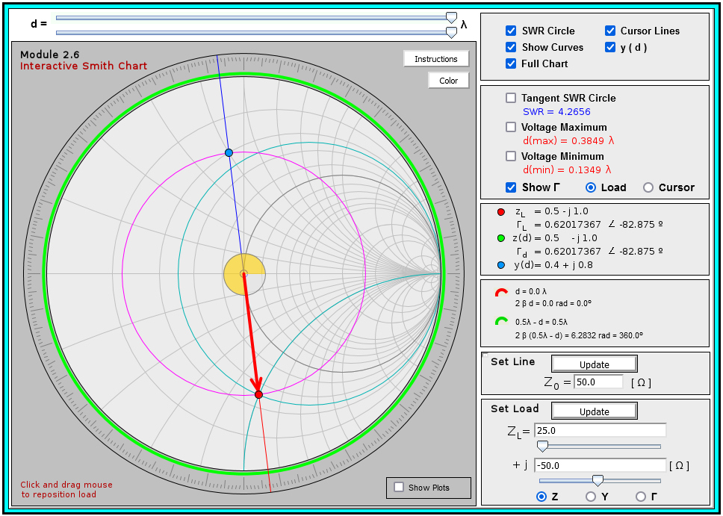
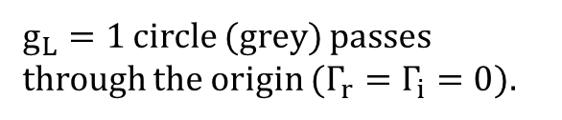



Lumped Element Matching Using Interactive Smith Chart
Smith Chart Solution procedure for Example 2-13: Determine both the distance in wavelengths from the load and value of a shunt element, i.e., inductor or capacitor, necessary to eliminate reflections from the load to the generator for a load impedance of $Z_{L}=\left(25−j50\right) Ω$ connected to a 50 Ω transmission line at f = 100 MHz.
Update the new Z_{L} and check
the y(d) box in upper right.
Normalized $z\left(d\right)=z_{L}=0.5−j1.0$.
Normalized $y\left(d\right)=y_{L}=\frac{1}{z_{L}}=0.4+j0.8$.
$g_{L}=1$ circle (grey) passes through the origin ($Γ_{r}=Γ_{i}=0$).
SWR circle (magenta)

Slide 26
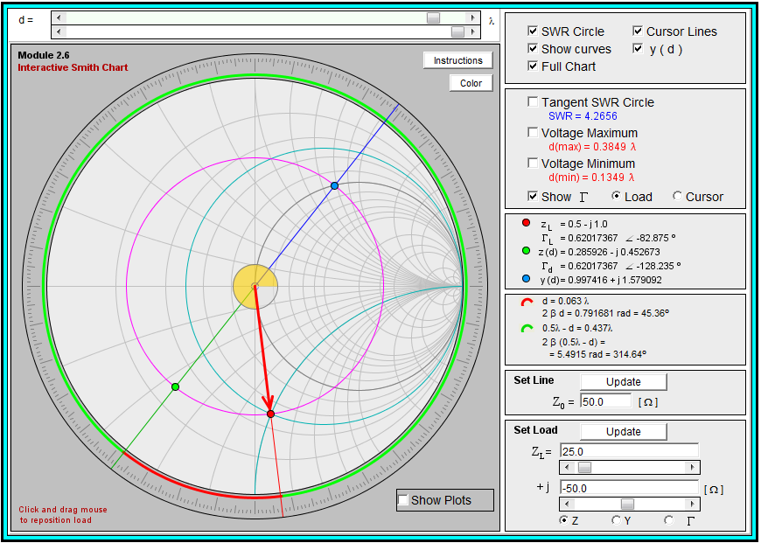

Lumped Element Matching (Continued)
Smith Chart Solution procedure for Example 2-13: Determine both the distance in wavelengths from the load and value of a shunt element, i.e., inductor or capacitor, necessary to eliminate reflections from the load to the generator for a load impedance of $Z_{L}=\left(25−j50\right)Ω$ connected to a 50 Ω transmission line at f = 100 MHz.
Next adjust slider bar d at the top of the window,
or use Left/Right arrow keys, so that y(d) (blue dot)
is moved to intersect the $g_{L}=1$ circle at both
intersection points, the inductive point corresponding
to the top half of the Smith Chart (Point C), and the
capacitive point corresponding to the bottom half of
the Smith Chart (Point D). referred to as point D. Read
off the resulting d value in terms of λ at each point.
Point C: $y_{d_C}=1.0+j1.58\text{. }d_{C}=0.063λ$.
Point D: $y_{d_C}=1.0−j1.58\text{. }d_{D}=0.207λ$.
Note that the adjacent Smith Chart is adjusted for
point C, i.e., d_{C}, and not point D for d_{D}.
Either a shunt inductor located at distance $d_{C}$ or a shunt capacitor located at $d_{D} will match the impedance.$
Point C
Point D

Slide 27
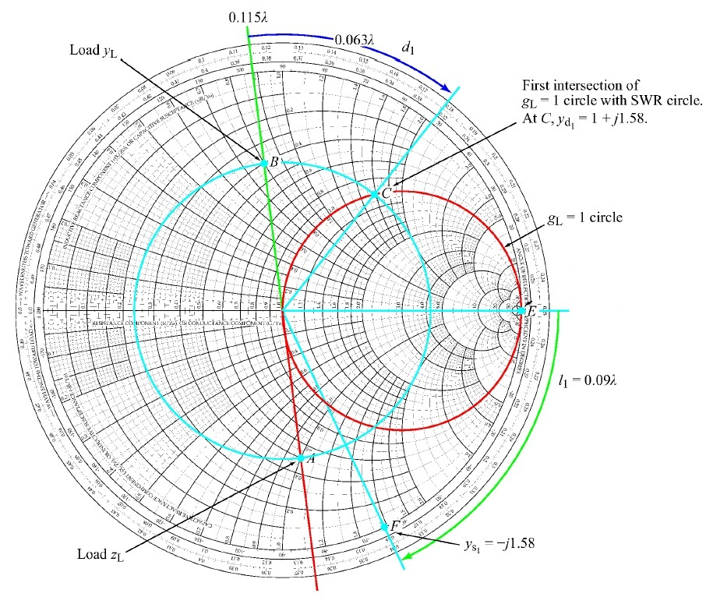

Lumped Element Matching Using Standard Smith Chart
Smith Chart Solution procedure for Example 2-13: Determine both the distance in wavelengths from the load and value of a shunt element, i.e., inductor or capacitor, necessary to eliminate reflections from the matching network to the generator for a load impedance of $Z_{L}=\left(25−j50\right)Ω$ connected to a 50 Ω transmission line at f = 100 MHz.
Normalized load impedance $z_{L}=\frac{Z_{L}}{Z_{0}}=0.5−j1.0.$ (Point A).
Using blue constant SWR circle and straight edge, point B
represents normalized load admittance $y_{L}=\frac{1}{z_{L}}=0.4+j0.8$.
WTG value for $y_{L}=0.115λ.$ Moving along a SWR circle on
a Smith chart corresponds to moving along the length of a
given transmission line.
Red circle represents $g_{L}=1$ circle, with two intersection
points with SWR circle, C and D, representing two possible
solutions:
Point C: $y_{d_C}=1.0+j1.58$. $WTG value=0.178λ$.
$d_{C}=\left(0.178λ−0.115λ\right)=0.063λ. d_{C}=0.063λ$.
Point D: $WTG value=0.322λ$.
$d_{D}=\left(0.322λ−0.115λ\right)=0.207λ. d_{D}=0.207λ$.
D

Slide 28
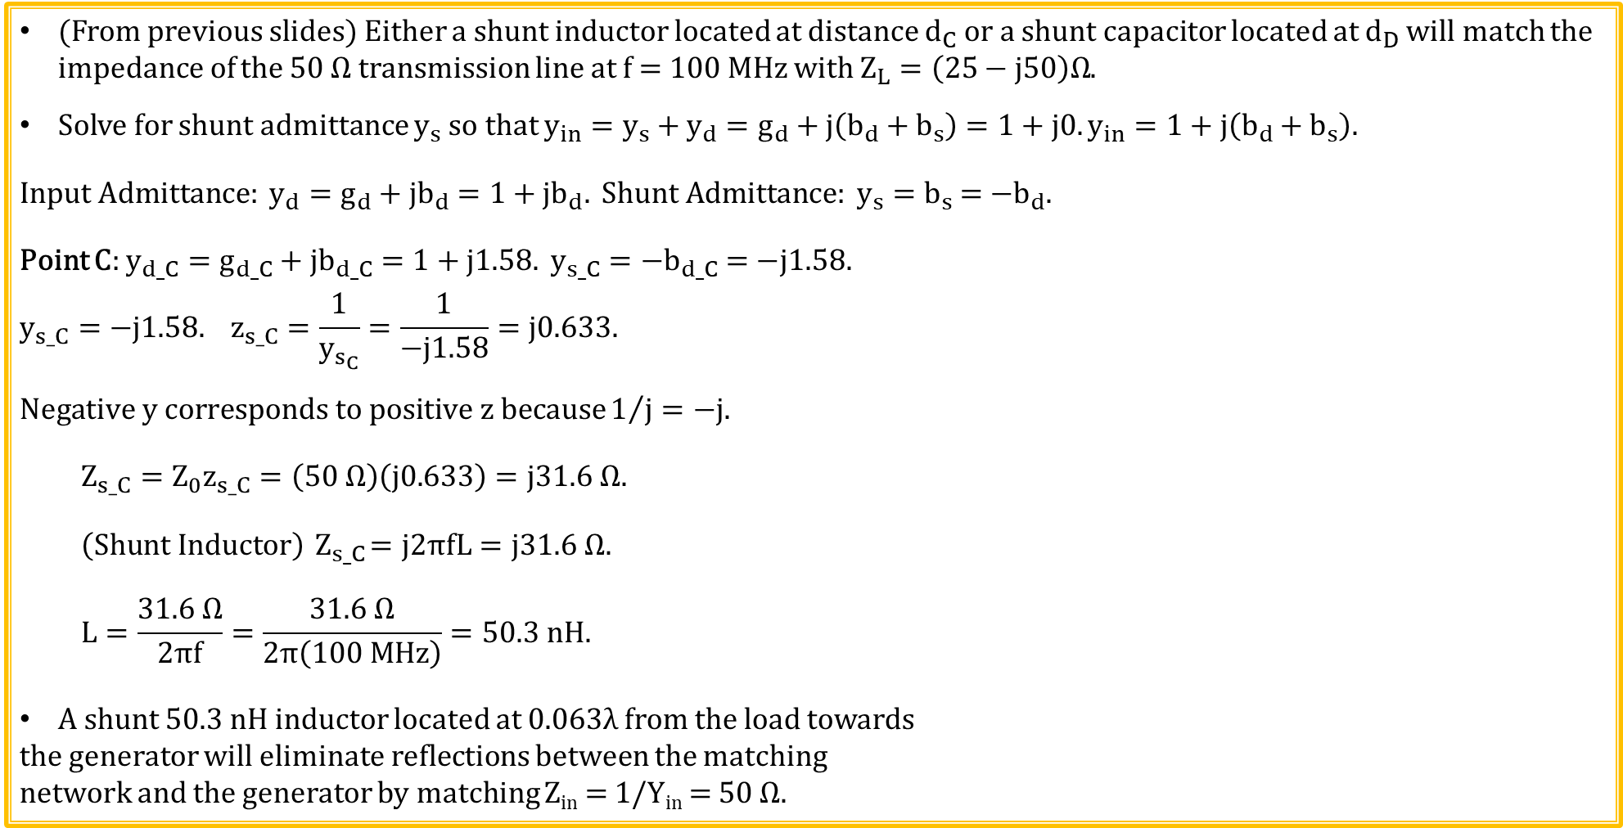
Lumped Element Matching Example 2-13: (Continued)
(From previous slides) Either a shunt inductor located at distance $d_{C}$ or a shunt capacitor located at $d_{D}$ will match the impedance of the 50 Ω transmission line at f = 100 MHz with $Z_{L}=\left(25−j50\right)Ω$.
Solve for shunt admittance $y_{s}$ so that $y_{in}=y_{s}+y_{d}=g_{d}+j\left(b_{d}+b_{s}\right)=1+j0. y_{in}=1+j\left(b_{d}+b_{s}\right).$
$Input Admittance: y_{d}=g_{d}+jb_{d}=1+jb_{d}. Shunt Admittance: y_{s}=b_{s}$ = ${−b}_{d}.$
Point C: $y_{d_C}=g_{d_C}+jb_{d_C}=1+j1.58. y_{s_C}={−b}_{d_C} =−j1.58.$
$$y_{s_C}=−j1.58. z_{s_C}=\frac{1}{y_{s_{C}}}=\frac{1}{−j1.58}=j0.633.$$
$Negative y corresponds to positive z because1/j=−j.$
$$Z_{s_C}=Z_{0}z_{s_C}=\left(50 Ω\right)\left(j0.633\right)=j31.6 Ω.$$
$\left(Shunt Inductor\right){ Z}_{s_C}=j2πfL=j31.6 Ω.$
$$L=\frac{31.6 Ω}{2πf}=\frac{31.6 Ω}{2π\left(100 MHz\right)}=50.3 nH.$$
A shunt 50.3 nH inductor located at 0.063λ from the load towards
the generator will eliminate reflections between the matching
network and the generator by matching Z_{in} = 1/Y_{in} = 50 Ω.
D

Slide 29
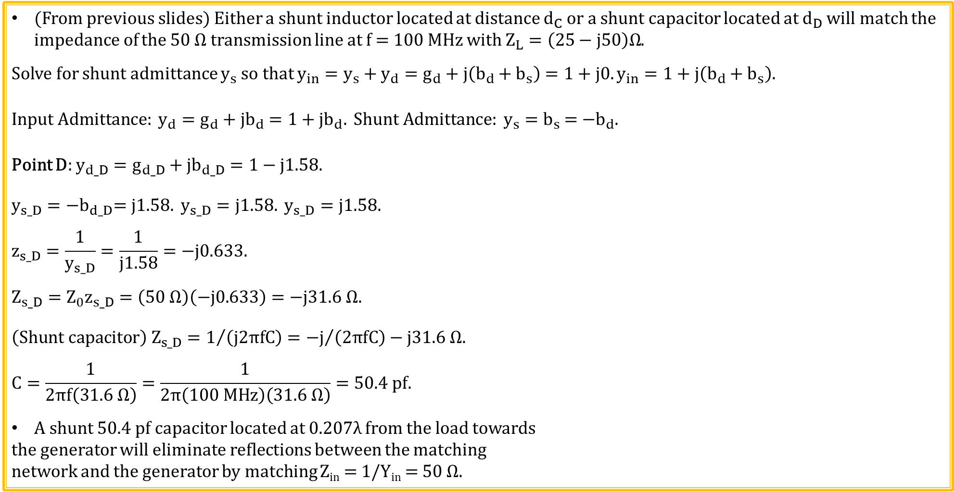
Lumped Element Matching Example 2-13: (Continued)
(From previous slides) Either a shunt inductor located at distance $d_{C}$ or a shunt capacitor located at $d_{D}$ will match the impedance of the 50 Ω transmission line at f = 100 MHz with $Z_{L}=\left(25−j50\right)Ω$.
Solve for shunt admittance $y_{s}$ so that $y_{in}=y_{s}+y_{d}=g_{d}+j\left(b_{d}+b_{s}\right)=1+j0. y_{in}=1+j\left(b_{d}+b_{s}\right).$
$Input Admittance: y_{d}=g_{d}+jb_{d}=1+jb_{d}. Shunt Admittance: y_{s}=b_{s}$ = ${−b}_{d}.$
Point D: $y_{d_D}=g_{d_D}+jb_{d_D}=1−j1.58.$
$$y_{s_D}={−b}_{d_D}=j1.58. y_{s_D}=j1.58. y_{s_D}=j1.58.$$
$$z_{s_D}=\frac{1}{y_{s_D}}=\frac{1}{j1.58}=−j0.633.$$
$Z_{s_D}=Z_{0}z_{s_D}=\left(50 Ω\right)\left(−j0.633\right)=−j31.6 Ω.$
$${\left(Shunt capacitor\right) Z}_{s_D}=1/{\left(j2πfC\right)}={−j}/{\left(2πfC\right)}−j31.6 Ω.$$
$$C=\frac{1}{2πf\left(31.6 Ω\right)}=\frac{1}{2π\left(100 MHz\right)\left(31.6 Ω\right)}=50.4 pf.$$
A shunt 50.4 pf capacitor located at $0.207λ$ from the load towards
the generator will eliminate reflections between the matching
network and the generator by matching Z_{in} = 1/Y_{in} = 50 Ω.
D

Slide 30



Lumped Element Matching Example 2-13: (Continued)
For a 50 Ω transmission line, Y₀ = 1/Y₀ =0.02 S.
Point C: (Check) $L=50.3 nH, located at 0.063λ from load towards generator.$
$$Y_{s}=1/{Z_{s}}=1/{\left(j2πfL\right)}=−j0.0316 S. y_{s}={Y_{s}}/{Y_{0}=}−j1.58.$$
$$y_{d_C}=1.0+j1.58. y_{in}=y_{s}+y_{d_C}=1.0.$$
$$Y_{in}=Y_{0}\left(y_{s}+y_{d}\right)={\left(y_{s}+y_{d}\right)}/{Z_{0}}=0.02 S. Y_{0}=1/{Z_{0}=0.02 S.}$$
$$Since Y_{in}=Y_{0}, no reflections from the matching network to the source occur.$$
Adding a 50 nH shunt inductor at distance 0.063λ from the load towards the
generator along the feedline eliminates reflections from the matching network
to the generator by matching Z_{in} = 1/Y_{in} = 50 Ω.
Point D: (Check) $C=50.4 pF, located at 0.207 λ from load towards generator.$
$$Y_{s}=1/{Z_{s}}=j2πfC=j0.0316 S. y_{s}={Y_{s}}/{Y_{0}=}j1.58.$$
$$y_{d_D}=1.0−j1.58. y_{in}=y_{s}+y_{d_C}=1.0.$$
$$Y_{in}=Y_{0}\left(y_{s}+y_{d}\right)={\left(y_{s}+y_{d}\right)}/{Z_{0}}=0.02 S. Y_{0}=1/{Z_{0}=0.02 S.}$$
$$Since Y_{in}=Y_{0}, no reflections from the matching network to the source occur.$$
Adding a 50 pF shunt capacitor at distance 0.207λ from the load towards the generator along the feedline eliminates reflections from the matching network to the generator by matching Z_{in} = 1/Y_{in} = 50 Ω.

Slide 31

Lumped Element Matching Summary
Use a matching network at terminals MM’ so as to eliminate reflections on
the feedline, which are undesirable for the generator.
Want Z_{in} at MM’ = Z₀, to eliminate feedline reflections.
Therefore, want normalized $y_{in}=y_{d}+y_{s}=\text{1 + }\text{j}\text{0.}$
Start with normalized load impedance: $z_{L}=r_{L}+jx_{L}$.
Convert to normalized load admittance, $y_{L}=g_{L}+jb_{L}$ by mean of Smith Chart.
$Find y_{d}=g_{d}+jb_{d}$ from the intersection of SWR circle with g_{L} = 1 circle,
which results in $g_{d}=1.$ Also record distance d in terms of λ from associated WTG value.
$Want y_{in}=g_{d}+j\left(b_{d}+b_{s}\right)=\text{1 + }\text{j}\text{0,}$ where$y_{s}=jb_{s}$ is the normalize susceptance of the shunt element.
Want $b_{s}={−b}_{d},$ so determine shunt element L or C value needed for normalized shunt element admitance y_{s} = -j$b_{d}$.
Locate the shunt C or L element at appropriate distance d from load based on fractional λ value from WTG scale.
This results in $y_{in}=\text{1 + }\text{j}\text{0,}$ which means that Y_{in} = Y_{O}$y_{in}$= Y_{O}, and therefore Z_{in} = Z₀, eliminating reflections between the feedline and matching network at MM’.

Slide 32


Transients on Transmission Lines
Transient response deals with initial transients on transmission lines, such as when a logic gate switches output states on a high-speed PCB.
Lossless Lumped Element Transmission Line model consists of two basic elements:
L’ - combined inductance of both conductors per unit length in H/m.
C’ – capacitance of the two conductors per unit length in F/m.
$$Initially, the impedance seen at the generator terminals is Z_{0}=\sqrt{\frac{L^{′}}{C^{′}}}.$$

Slide 33


Transients on Transmission Lines (Continued)
For transmission lines that are electrically long, the resulting transient response is far from the ideal expected for an electrically short transmission line, and can result in erroneous digital data.
For adjacent transmission line at t = 0+, generator circuit only sees
characteristic impedance of the transmission line Z₀.
$At generator positive terminal, initial Current→I_{1}^{+}=\frac{V_{g}}{R_{g}+{ Z}_{0}}.$
$At generator terminals, initial Voltage→V_{1}^{+}=I_{1}^{+}Z_{0}=\frac{V_{g}{ Z}_{0}}{R_{g}+{ Z}_{0}}. Voltage Divider.$
For an infinitely long transmission line, the voltage at the generator
terminals always equals $V_{1}^{+}$.
For practical transmission lines, reflections occur when impedances
are not matched. Time for first reflection at z = l equals T = l/u_{p} where u_{p} is the phase velocity of the waveform.

Slide 34




Transients on Transmission Lines (Continued)
$$Reflection Coefficient at the load: Γ_{L}=\frac{{R_{L}−Z}_{0}}{{R_{L}+Z}_{0}}=0.333.$$
$$Reflection Coefficient at the Generator: Γ_{g}=\frac{{R_{g}−Z}_{0}}{{R_{g}+Z}_{0}}=0.6.$$
Initial wave-front at generator end:
$$V_{1}^{+}=I_{1}^{+}Z_{0}=\frac{V_{g}{ Z}_{0}}{R_{g}+{ Z}_{0}}.$$
First reflection from the load:
$$V_{1}^{−}={Γ_{L}V}_{1}^{+}.$$
First returning reflection from the generator end:
$$V_{2}^{+}={Γ_{g}V}_{1}^{−}.$$
Second reflection from the load:
$$V_{2}^{−}={Γ_{L}V}_{2}^{+}.$$
Second returning reflection from the generator end:
$$V_{3}^{+}={Γ_{g}V}_{2}^{−}.$$
$$R_{g}=4Z_{0}$$
$$R_{L}=2Z_{0}$$

Slide 35



Transients on Transmission Lines (Continued)
The multiple reflection process continues indefinitely, and
the ultimate value that V(z, t) reaches as t approaches +∞ is
the same at all locations on the transmission line.
Steady-state line voltage $→$ $V_{∞}=\frac{V_{g}{ R}_{L}}{R_{g}+{ R}_{L}}.$
Steady-state line current $→$ $I_{∞}=\frac{V_{∞}}{R_{L}}=\frac{V_{g}}{R_{g}+{ R}_{L}}.$
What about reflections occurring between R_{g} and
the generator terminals for R_{g} ≠ Z₀?
This distance is often electrically short, so usually
can be ignored.
$$R_{g}=4Z_{0}$$
$$R_{L}=2Z_{0}$$

Slide 36

Bounce Diagrams
Graphical representation of multiple reflections.
x-axis corresponds to distance along transmission line.
y-axis corresponds to time, with T corresponding to the
one way travel time along the transmission line.
Use reflection coefficients at load and generator to
determine magnitude associated with zig-zag lines.
Can construct resulting voltage or current at a given
distance along the transmission line utilizing vertical lines
at the desired distance. Total voltage or current is the
algebraic sum of individual zig-zag lines intersecting the
associated vertical line.
The adjacent voltage versus time diagram is for a
distance of l/4 down the line from the generator , which
is why the voltage equals zero until time t = T/4.

Slide 37



Transient Response Example
For the adjacent circuit with V_{g} = 10 V, R_{g} = 75 Ω and Z₀ = 75 Ω,
determine the resulting transient response waveform at switch
closure time t = 0 for the voltage at the input to the transmission
line, i.e., z = 0. The time T = l/u_{p} where u_{p} is the phase velocity of
the waveform down the transmission line.
$$Γ_{L}=\frac{V_{0}^{−}}{V_{0}^{+}}=\frac{{R_{L}−Z}_{0}}{{R_{L}+Z}_{0}}=−1. Γ_{g}=\frac{R_{g}−Z_{0}}{R_{g}+Z_{0}}=0.$$
$$V_{1}^{+}=\frac{\left(10 V\right)Z_{0}}{R_{g}+Z_{0}}=\frac{\left(10 V\right)\left(75 Ω\right)}{150 Ω}=5 V. { V}_{1}^{+}=5 V.$$
$$V_{1}^{−}=Γ_{L}V_{1}^{+}={−V}_{1}^{+}=−5 V.$$
$$V_{2}^{+}=Γ_{g}V_{1}^{−}=0.$$
5 V
-5 V

Slide 38





Transient Response Example (Continued)
For the adjacent circuit with V_{g} = 10 V, R_{g} = 75 Ω and Z₀ = 75 Ω,
determine the resulting transient response waveform at switch
closure time t = 0 for the voltage at the input to the transmission
line, i.e., z = 0. The time T = l/u_{p} where u_{p} is the phase velocity of
the waveform down the transmission line.
Vertical distance lines from the
Bounce Diagram provide the necessary
information to plot the resulting waveforms
at any distance l.
Poll Questions
V(t) at distance z = 0, i.e., Generator.
V(t) at distance z = l, i.e., Load.
$$V_{1}^{+}and V_{1}^{−} cancel each other out$$
$$at the generator at this time.$$
$$V_{1}^{+}and V_{1}^{−} cancel each other$$
$$out at the load at this time.$$

Slide 39



Digital Logic Bounce Diagram
$$V_{1}^{+}=\frac{V_{g}{ Z}_{0}}{R_{g}+{ Z}_{0}}=\frac{(5.0 V)(50Ω)}{5 Ω+50Ω}=4.545V.$$
$$V_{1}^{+}=4.545 V.$$
$$Γ_{g}=\frac{{R_{g}−Z}_{0}}{{R_{g}+Z}_{0}}=\frac{5 Ω−50 Ω}{5 Ω+50 Ω}=−0.8181.$$
$$Γ_{g}=−0.8181.$$
$$Γ_{L}=\frac{{R_{L}−Z}_{0}}{{R_{L}+Z}_{0}}=\frac{10 MΩ−30 Ω}{10 MΩ+30 Ω}=1.00. Γ_{L}=1.000.$$

Slide 40


Digital Logic Bounce Diagram Continued)
$$V_{1}^{+}=4.545 V. Γ_{L}=1.000. Γ_{g}=−0.8181.$$
$${Γ_{L}V}_{1}^{+}=4.545 V. Γ_{g}{Γ_{L}V}_{1}^{+}=−3.718 V. Γ_{g}{Γ_{L}^{2}V}_{1}^{+}=−3.718 V.$$
$${{Γ_{g}^{2}Γ}_{L}^{2}V}_{1}^{+}=3.042 V. {{Γ_{g}^{2}Γ}_{L}^{3}V}_{1}^{+}=3.042 V. {{Γ_{g}^{3}Γ}_{L}^{3}V}_{1}^{+}=−2.489 V.$$
$${{Γ_{g}^{3}Γ}_{L}^{4}V}_{1}^{+}=−2.489 V.$$

Slide 41


Digital Logic Bounce Diagram Continued)
4.545 V
0.000 V
4.545 V + 4.545 V = 9.090 V.
9.090 V
5.372 V
9.090 V
1.654 V
7.738 V
4.696 V
7.738 V
5.372 V
5.249 V
4.545 V
4.696 V
5.249 V
2.760 V
2.760 V
1.654 V
0.000 V

Slide 42



Digital Logic Bounce Diagram with Termination Resistor
$$V_{1}^{+}=\frac{V_{g}{ Z}_{0}}{R_{g}+{ Z}_{0}}=\frac{(5.0 V)(50Ω)}{5 Ω+50Ω}=4.545V.$$
$$V_{1}^{+}=4.545 V.$$
$$Γ_{g}=\frac{{R_{g}−Z}_{0}}{{R_{g}+Z}_{0}}=\frac{5 Ω−50 Ω}{5 Ω+50 Ω}=−0.8181.$$
$$Γ_{g}=−0.8181.$$
$$Γ_{L}=\frac{{R_{L}−Z}_{0}}{{R_{L}+Z}_{0}}=\frac{100 Ω−50 Ω}{100 Ω+50 Ω}=0.3333. Γ_{L}=0.3333.$$

Slide 43


Transient Response Measurement
Use Function Generator with relatively low-frequency square wave output with 20 V pk-pk amplitude for fast rise-time edge.
Use coaxial cable with Z₀ ≈ R_{g}.
$$Travel Time from Generator to Load and Back: t_{two_way}=\frac{2l}{u_{p}}.$$
$$Knowing u_{p} allows for measurement of length l: l=\frac{{u_{p}t}_{two_way}}{2}.$$
$$Knowing length l allows for measurement of propagation velocity u_{p}: u_{p}=\frac{2l}{t_{two_way}}.$$
Notes:
Go to web Fundamentals of Applied Electromagnetics to download Interactive Modules available for the Ulaby – Fundamentals of Applied Electromagnetics text. Windows 10 has Java security issues that can be fixed as follows:
Java → Java Security → See Security Tab → Exception Site List. Add the following to the Exception Site List: http://em7e.eecs.umich.edu.

Slide 44



Transient Response Measurement Example
Use Function Generator with relatively low-frequency square wave output
with 20 V pk-pk amplitude for fast rise-time edge.
$Knowing length l=75 ft allows for measurement$
$$of propagation velocity u_{p}: u_{p}=\frac{2l}{t_{two_way}}.$$
L = 75 ft = 22.86 meters. $t_{two_way}$ = 232 nS.
Calculate the $propagation velocity u_{p}:$
$$u_{p}=\frac{2l}{t_{two_way}}=\frac{2\left(22.86 m\right)}{232 ns}=197 x {10}^{6} m/s.$$
$$\frac{u_{p}}{c}=\frac{197 x {10}^{6} m/s}{300 x {10}^{6} m/s}=0.657c.\left(2/3\right)c=0.667c.$$

Slide 45


Time Domain Reflectometer (TDR) for Cable Testing
TDRs consists of fast (< 200 ps) step generator and
fast sampler to measure the resulting signal voltage.
Expensive to dig up and repair buried cable.
$u_{P}= c/{\sqrt{ε_{r}μ_{r}}}=$ $c/{\sqrt{ε_{r}}}$ for µ_{r} = 1 which is
true for most cables.
Location of unwanted impedance mismatch
can be determined by means of a TDR.

Slide 46

Soil Moisture Measurements Using Permittivity
Irrigation water becoming a more precious resource.
Air has ε_{r} essentially equal to 1. Liquid H₂O has ε_{r} = 80 @ 20 °C. Other soil constituents have ε_{r} < 10.
Therefore, $u_{P}$ is a strong function of water content of soil.
$u_{p}= c/{\sqrt{ε_{r}μ_{r}}}=$ $c/{\sqrt{ε_{r}}}$ for µ_{r} = 1 which is true for soils.
$u_{p}∝1/{\sqrt{ε_{r}}}$ in soils.
Permittivity sensors are commonly used to arrive at soil water content.
Standard equations available to convert from permittivity to soil water content.

Slide 47

Time Domain Reflectometer (TDR) for Soil Moisture Measurements
TDRs consists of fast (< 200 ps) step generator and fast sampler to measure the resulting signal voltage.
Provides an excellent way to measure permittivity for soil water content.
TDR is preferred way to measure soil moisture content by research scientists.
TDR100 used for soil moisture measurements and costs ≈ $4000.
Less expensive TDR for soil moisture measurements is desirable and being pursued by multiple companies.
Open-Ended Transmission Line

Slide 48

TDR for Soil Moisture Measurements (Continued)
Down and back travel time on TDR probe equals Δt = t2 – t1.
$u_{P}={2l}/{∆t∝1/{\sqrt{ε_{r}}}.}$ Standard equations convert $ε_{r}$ to soil water content.
Voltage
t1
t2
Time

Slide 49


Transmission Line Oscillator
Cost $\sim$$200 per sensor.
Two rods inserted into the soil, forming an
open-ended transmission line.
Returning reflections trigger launching of
opposite polarity differential signal.
Oscillation frequency decreases for increasing water content, because $u_{p}∝1/{\sqrt{ε_{r}}}$.
Referred to as TDR (Time Domain Reflectometry) oscillator.
Some Soils have appreciable electrical conductivity which complicates measurements.

Slide 50
ECEN 390 – Electromagnetics Topics
Waves and Phasors
Transmission Lines
Vector Calculus
Electrostatics
Magnetostatics
Time Varying Fields
Plane Wave Propagation
Radiation and Antennas
Satellites and Radar

Slide 51
Extra

Slide 52

Smith Charts (Continued)
$$r_{L}=\frac{1−Γ_{r}^{2}−Γ_{i}^{2}}{{\left(1−Γ_{r}\right)}^{2}+Γ_{i}^{2}}, \left(real part\right). r_{L}{\left(1−Γ_{r}\right)}^{2}+{r_{L}Γ}_{i}^{2}=1−Γ_{r}^{2}−Γ_{i}^{2}. r_{L}−2r_{L}Γ_{r}{{ + r}_{L}Γ}_{r}^{2}{+r_{L}Γ}_{i}^{2}=1−Γ_{r}^{2}−Γ_{i}^{2}.$$
$$−2r_{L}Γ_{r}{{ + r}_{L}Γ}_{r}^{2}{+r_{L}Γ}_{i}^{2}+ Γ_{r}^{2} +Γ_{i}^{2}=1−r_{L}.{ Γ}_{r}^{2}{{ + r}_{L}Γ}_{r}^{2}+Γ_{i}^{2}{+r_{L}Γ}_{i}^{2}−2r_{L}Γ_{r}=1−r_{L}.$$
$${ \left(1+r_{L}\right)Γ}_{r}^{2} + {\left(1+r_{L}\right)Γ}_{i}^{2}−2r_{L}Γ_{r}=1−r_{L}.{ Γ}_{r}^{2}−\frac{2r_{L}}{1+r_{L}}Γ_{r}+Γ_{i}^{2}=\frac{1−r_{L}}{1+r_{L}}.$$
$${ Add and subtract \frac{{r_{L}}^{2}}{{\left(1+r_{L}\right)}^{2}} terms to complete the square: Γ}_{r}^{2}−\frac{2r_{L}}{1+r_{L}}Γ_{r}+\frac{{r_{L}}^{2}}{{\left(1+r_{L}\right)}^{2}}−\frac{{r_{L}}^{2}}{{\left(1+r_{L}\right)}^{2}}{+ Γ}_{i}^{2}=\frac{1−r_{L}}{1+r_{L}}.$$
$${ Γ}_{r}^{2}−\frac{2r_{L}}{1+r_{L}}Γ_{r}+\frac{{r_{L}}^{2}}{{\left(1+r_{L}\right)}^{2}}{+ Γ}_{i}^{2}=\frac{1−r_{L}}{1+r_{L}}+\frac{{r_{L}}^{2}}{{\left(1+r_{L}\right)}^{2}}.$$
$${\left(Γ_{r}^{2} −\frac{r_{L}}{1+r_{L}}\right)}^{2}{+ Γ}_{i}^{2}=\frac{{{\left(1−r_{L}\right)}^{2}−r_{L}}^{2}}{{\left(1+r_{L}\right)}^{2}}=\frac{{1−{r_{L}}^{2}+r_{L}}^{2}}{{\left(1+r_{L}\right)}^{2}}=\frac{1}{{\left(1+r_{L}\right)}^{2}}={\left(\frac{1}{1+r_{L}}\right)}^{2}.$$
$${\left(Γ_{r} −\frac{r_{L}}{1+r_{L}}\right)}^{2}{+ Γ}_{i}^{2}={\left(\frac{1}{1+r_{L}}\right)}^{2}.$$
$Equation of a circle in terms of variables Γ_{r} and Γ_{i} for each r_{L} value with center at \left(Γ_{r}=\frac{r_{L}}{1+r_{L}},Γ_{i}=0\right) and radius\frac{1}{1+r_{L}}.$

Slide 53

SWR, Voltage Maxima and Minima
$Voltage standing wave ratio, i.e. ,VSWR − S=\frac{\left|\tilde{V}\right|max}{\left|\tilde{V}\right|min}=\frac{1+\left|Γ\right|}{1−\left|Γ\right|}. Rearranging results in \left|Γ\right|=\frac{S−1}{S+1}.$
As a result the circle corresponding to a
constant $\left|Γ\right|$ value also corresponds to a
circle of constant $S=\frac{1+\left|Γ\right|}{1−\left|Γ\right|}$ value and vice versa.
$$VSWR − S=\frac{\left|\tilde{V}\right|max}{\left|\tilde{V}\right|min}=\frac{1+\left|Γ\right|}{1−\left|Γ\right|}, where Γ=\left|Γ\right|e^{jθ_{r}}$$
Points P_{max} and P_{min} correspond to $Γ_{i}=0.$
$Γ=\frac{z_{L}−1}{z_{L}+1}$, where $z_{L}=r_{L}+{jx}_{L}. For Γ_{i}=0$, $x_{L}=0.$
Therefore, $Γ=Γ_{r}=\frac{r_{0}−1}{r_{0}+1} \text{for} \text{points} P_{max} and P_{min}\text{,}$
where $r_{0}≜$ $r_{L}$ at intersection points $P_{max} and P_{min}.$
$\left|Γ\right|=\frac{S−1}{S+1}. At P_{max},\left|Γ\right|=Γ_{r}=\frac{S−1}{S+1}$.

Slide 54

Impedance Matching using Open Circuit Stubs

Slide 55

SWR, Voltage Maxima and Minima (Continued)
Constant $\left|Γ\right|$ and therefore S corresponds to circles with center located at origin, i.e., $Γ_{r}$ = 0, $Γ_{i}$ = 0.
$VSWR → S=\frac{\left|\tilde{V}\right|max}{\left|\tilde{V}\right|min}=\frac{1+\left|Γ\right|}{1−\left|Γ\right|}, where Γ_{d}=\left|Γ\right|e^{j{(θ}_{r}−2βd)}.$
At P_{max}, $θ_{r}−2βd=0, ±2π, …$, which is the condition for $\left|\tilde{V}\right|max.$
At P_{min}, $θ_{r}−2βd=±π, ±3π…$, which is the condition for $\left|\tilde{V}\right|min.$
$\left|\tilde{V}\right|max$ corresponds to point P_{max} located on the $Γ_{r}$ axis ($Γ_{i}=0$),
to the right of the chart center.
$\left|\tilde{V}\right|min$ corresponds to point P_{min} located on the $Γ_{r}$ axis ($Γ_{i}=0$),
to the left of the chart center.
P_{max} and P_{min} represent locations of $\left|\tilde{V}\right|max$ and$\left|\tilde{V}\right|min$,
and not power.
Total distance around the Smith chart is $λ/2.$
Therefore, distance from $\left|\tilde{V}\right|max$ to $\left|\tilde{V}\right|min$ = $λ/4.$

Slide 56

Lumped Element Matching Example (Continued)
Solve for shunt admittance $y_{s}$ so that $y_{in}=1+j0=y_{s}+y_{d}. y_{s}=1−y_{d}, where y_{d}=g_{d}+jb_{d}.$
Point C: $y_{d_C}=g_{d_C}+jb_{d_C}=1+j1.58. y_{s_C}=1−y_{d_C}=1− 1.0−j1.58=−j1.58. y_{s_C}=−j1.58.$
$$Z_{s_C}=Z_{0}z_{s_C}=\frac{Z_{0}}{y_{s_C}}=\frac{50 Ω}{−j1.58}=\frac{j50 Ω}{1.58}=j31.6 Ω.$$
$\left(Shunt Inductor\right){ Z}_{s_C}=j2πfL. j2πfL=j31.6 Ω.$
$$L=\frac{31.6 Ω}{2πf}=\frac{31.6 Ω}{2π\left(100 MHz\right)}=50.3 nH.$$
$$L=50.3 nH.$$
Point D: $y_{d_D}=g_{d_D}+jb_{d_D}=1−j1.58.$
$$y_{s_D}=1−y_{d_{D}}=1− 1.0+j1.58=j1.58.$$
$$y_{s_D}=j1.58.$$
$Z_{s_D}=Z_{0}z_{s_D}=\frac{Z_{0}}{y_{s_D}}=\frac{50 Ω}{j1.58}=\frac{−j50 Ω}{1.58}=−j31.6 Ω.$
$${\left(Shunt capacitor\right) Z}_{s_D}=1/{\left(j2πfC\right)}={−j}/{\left(2πfC\right).}$$
$${−j}/{\left(2πfC\right)}=−j31.6 Ω.$$
$$C=\frac{1}{2πf\left(31.6 Ω\right)}=\frac{1}{2π\left(100 MHz\right)\left(31.6 Ω\right)}=50.4 pf.$$
$$C=50.4 pf.$$
D
D

Slide 57


Smith Charts (Continued)
$${Γ=Γ_{r}+{jΓ}_{i}=\frac{z_{L}−1}{z_{L}+1}. z}_{L}=r_{L}+{jx}_{L}=\frac{1+Γ}{1−Γ}. Smith Chart graphically represents these relationships.$$
Point | $Γ$ =$Γ_{r}+{jΓ}_{i}$ | $$z_{L}=r_{L}+{jx}_{L}$$
A
B
C
D
0 + j0 ↔ 0$∠0°$ 1 + j0 (matched)
-1 + j0 ↔ 1$∠\left(−180°\right)$ 0 + j0 (short)
1 + j0 ↔ 1$∠0°$ ∞ + j0 (open)
0.52 – j0.64 ↔ 0.825$∠\left(−50.9°\right)$ 0.5 – j2 (capacitive)
Given a $z_{L}$ value, how do you determine $\left|Γ\right|$ on a Smith Chart?
By using length ratios. Using a ruler, measure length $\overline{AC}$, along with length $\overline{AD}. Then$determine $\left|Γ\right|$ as the ratio of ${\overline{AD}}/{\overline{AC}.}$ This ratiometric measurement approach gives the correct ratio independent upon the size of the Smith Chart. Actual Smith Charts have a distance scale along the bottom to help with $\left|Γ\right|.$
How do you determine $θ_{r}$ associated with $Γ$ on a Smith Chart?
Actual Smith Charts have a reflection coefficient angle scale (θ_{r}) along the perimeter$.$
B
A
C
D

Slide 58


Transient Response Simulator
Go to web Fundamentals of Applied Electromagnetics to run or download Interactive Modules available for the Ulaby – “Fundamentals of Applied Electromagnetics” text. Run T-Line Simulator mod2-10_webstart.jnlp from Chapter 2 for this activity.
The Transient Response simulator provides transient response versus time waveforms for different line and load parameters. Transient Response mod2_10.
Notes:
Go to web Fundamentals of Applied Electromagnetics to download Interactive Modules available for the Ulaby – Fundamentals of Applied Electromagnetics text. Windows 10 has Java security issues that can be fixed as follows:
Java → Java Security → See Security Tab → Exception Site List. Add the following to the Exception Site List: http://em7e.eecs.umich.edu.

